Slide 1
Hamster Capstone
By: Jared Hemauer, Rylee Horney, Keenan Keams, Joseph Lopez
Spring 2024 – Fall 2024

Slide 2

Project Description
A robot to provide affordable stroke rehabilitation for patients in need.
Reducing time and costs for physical therapy
Goal is to target arm and hand movement during recovery to gain mobility
Decrease the amount of “In Patient” care for physical therapists
Sponsor: Dr. Reza Sharif Razavian, NAU Professor

Slide 3
Deliverables and Success Metrics
Deliverables
Create a robot using engineering concepts
Perform calculations to help determine design choices
Meet performance standards through the course
Communication with client updating specifications and progress on the build
Functional and meets client requirements
  10 N of force output
  5Nm of torque
  Useable for 30 minutes
  Easy for patients to use
  Lightweight and mobile on a table
Success Metrics
Functioning robot that moves the weight of a patient's arm
A robot that will produce 10N of force to the patient's arm in exercises
Device will last up to 30 mins
Provide feedback on the position of the robot to create exercises for users

Slide 4
Customer Requirements
Must Move 10N​
Handheld​
Moves at 1m/s​
Have 5 Nm of Torque​
Bidirectional Communication​
Inexpensive​
Comfortable​
Ease of Use​
Rechargeable w/ 30-minute battery life​

Slide 5
Engineering Requirements
Motor Torque (Nm) – the motor must be able to produce enough torque to output a force of 10N on the patient’s hand.
Battery Life (kW hr ) – needs to last at least 30 minutes under load.
Battery Amperage (A) - need to be able to produce enough current for all components in the robot at least 6 Ah (i.e. three motors, raspberry pi, sensors, motor controller, and screen)
Size (ft) – less than 1ftx1ftx1ft
CPU Speed (s) – the microcontroller needs to be able to send commands quickly so there is minimal delay in the movement of the robot. (16 MHz)
Weight (lb.) - less than 10lbs

Slide 6
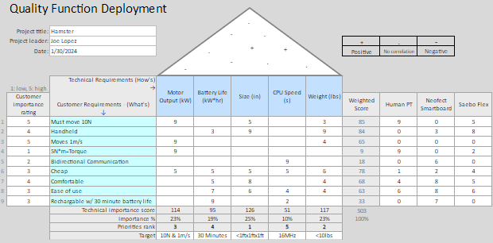
House of Quality

Slide 7
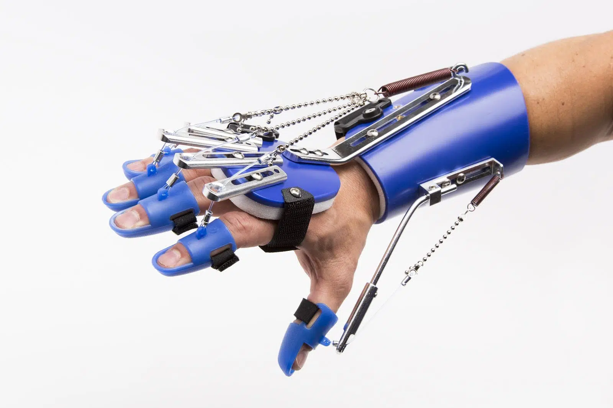
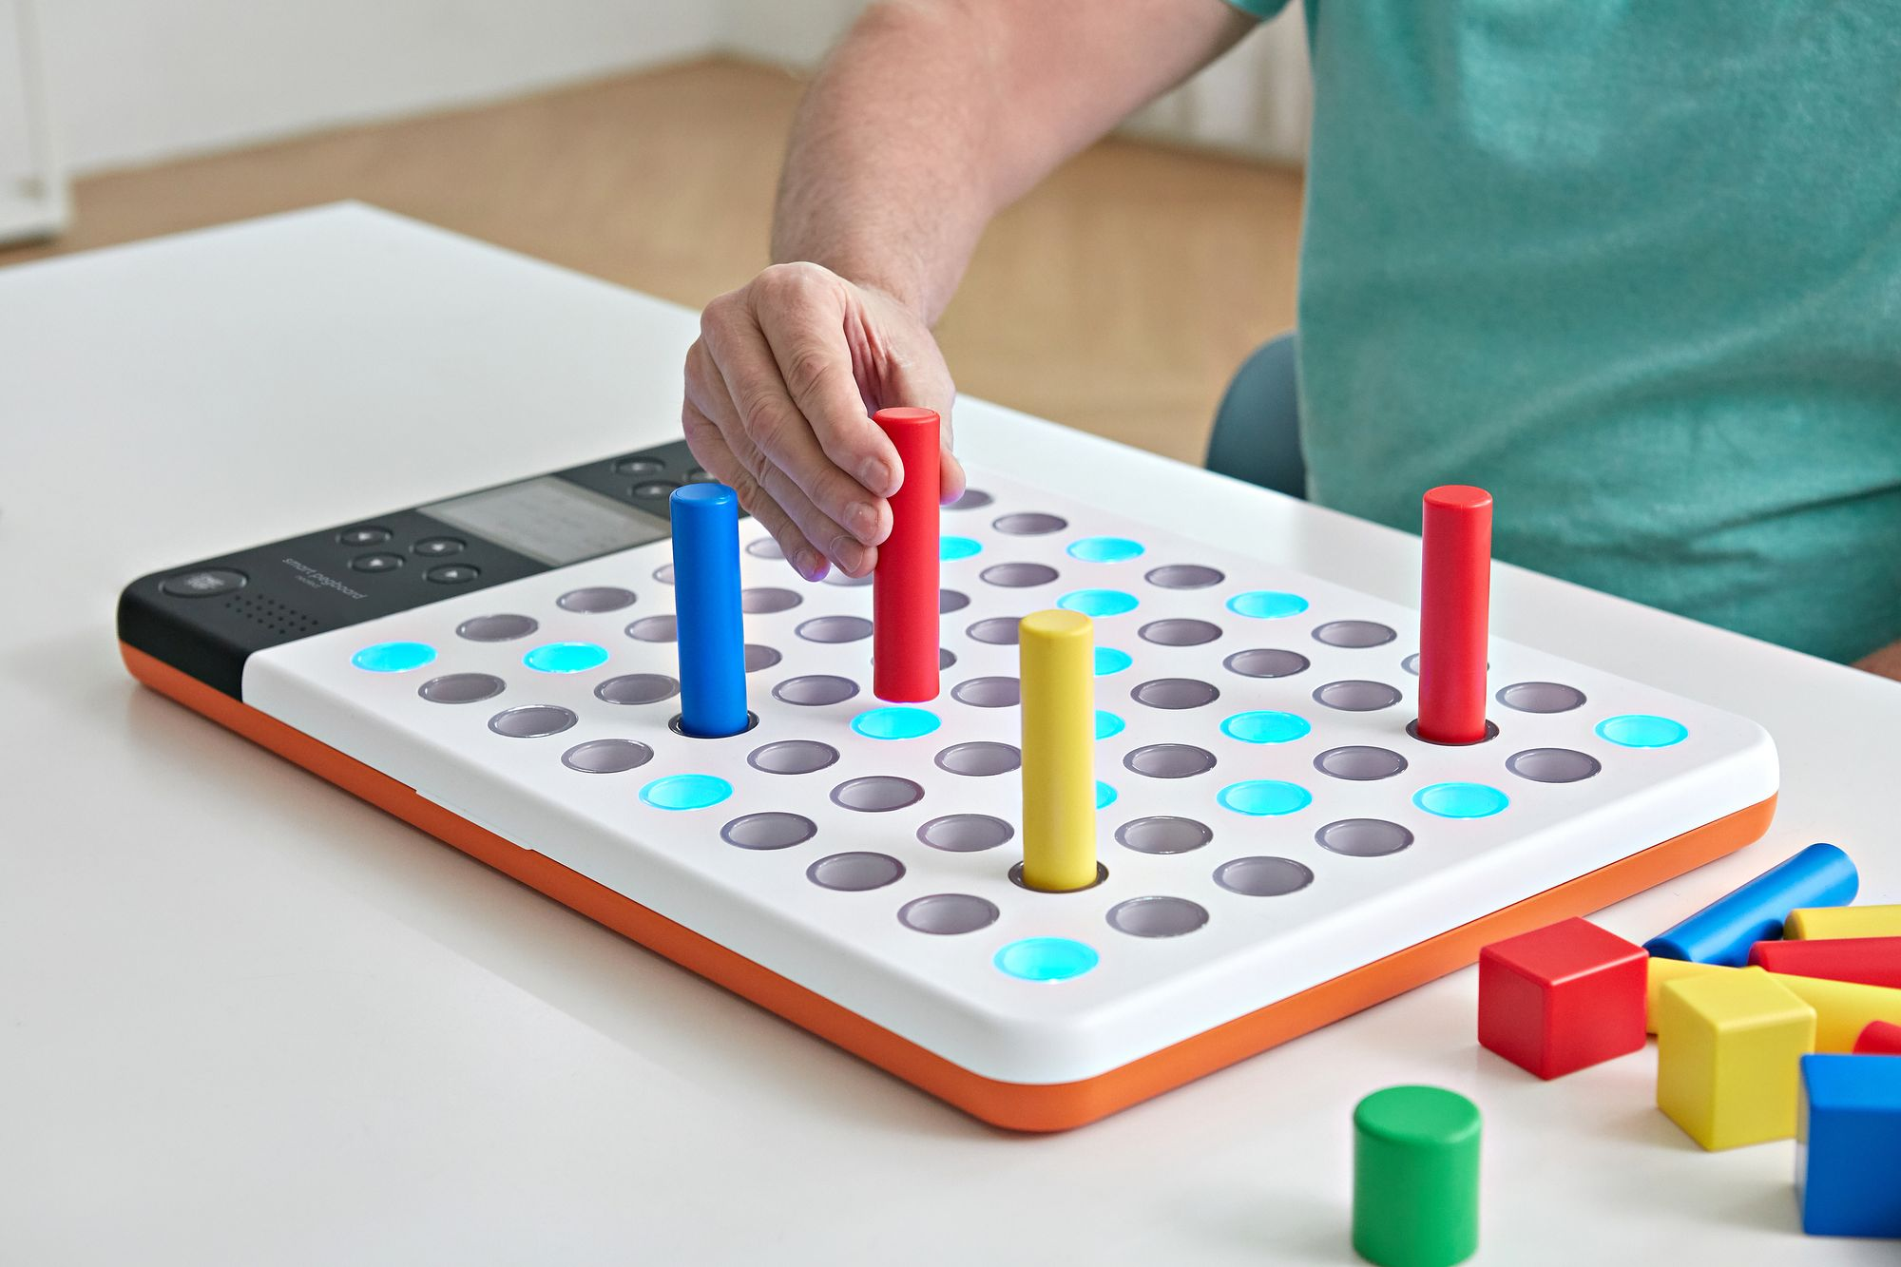
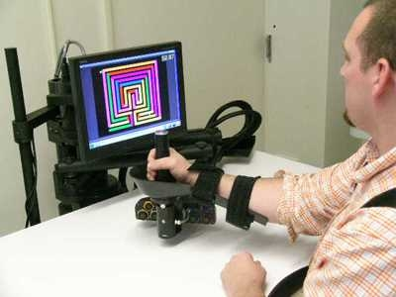
Benchmarking
(Figure 1: SaeboFlex)
(Figure 2: Neofect Smart Pegboard)
(Figure 3: MIT Robot)

Slide 8
Literature Review
[1]J. Brackenridge, L. V. Bradnam, S. Lennon, J. J. Costi, and D. A. Hobbs, “A Review of Rehabilitation Devices to Promote Upper Limb Function Following Stroke,” Neuroscience and Biomedical Engineering, vol. 4, no. 1, pp. 25–42, Mar. 2016
[2]P. Weiss, M. Heldmann, A. Gabrecht, Achim Schweikard, T. M. Münte, and E. Maehle, “A Low Cost Tele-Rehabilitation Device for Training of Wrist and Finger Functions After Stroke,” A low cost tele-rehabilitation device for training of wrist and finger functions after stroke, Jan. 2014
[3]T. Georgiou, S. Holland, and Janet, “Wearable haptic devices for post-stroke gait rehabilitation,” Open Research Online (The Open University), Sep. 2016
[4]L. Riek, Healthcare robotics, vol. 60, no. 11, Oct. 2017
[5]J. Duval et al., “Designing Spellcasters from Clinician Perspectives,” ACM Transactions on Accessible Computing, vol. 15, no. 3, Apr. 2022
[6]C. Axel et al., “Engineering Rehabilitation: Blending Two Tool-supported Approaches to Close the Loop from Tasks-based Rehabilitation to Exercises and Back Again,” Proceedings of the ACM on human-computer interaction, vol. 7, no. EICS, pp. 1–23, Jun. 2023
[7]Dharmaraja Selvamuthu and P. Tardelli, “Partial Observed Fluid Queue Model for Rechargeable Batteries,” Partial Observed Fluid Queue Model for Rechargeable Batteries, May 2020
[8]R. Ramirez, “How to Power Your Raspberry Pi With a Battery,” Circuit Basics, Jul. 29, 2021. https://www.circuitbasics.com/how-to-power-your-raspberry-pi-with-a-lithium-battery/
[9]S. Hu, H. Chen, and Y. Shao, “Triangular Omnidirectional Wheel Motion Control System,” OALib, vol. 07, no. 08, pp. 1–8, 2020, doi: https://doi.org/10.4236/oalib.1106677.
[10]Pololu, “Pololu Motoron Motor Controller User’s Guide,” www.pololu.com. https://www.pololu.com/docs/0J84/all (accessed Apr. 27, 2024).

Slide 9
Literature Review
[11] John Ryan C. Dizon, Alejandro H. Espera, Qiyi Chen, Rigoberto C. Advincula,Mechanical characterization of 3D-printed polymers, Additive Manufacturing, Volume 20, 2018, Pages 44-67
[12] E. Macdonald et al., "3D Printing for the Rapid Prototyping of Structural Electronics," in IEEE Access, vol. 2, pp. 234-242, Dec. 2014
[11] C. Wang et al., “Trajectory tracking of an omni-directional wheeled mobile robot using a model predictive control strategy,” Applied Sciences, vol. 8, no. 2, p. 231, Feb. 2018. doi:10.3390/app8020231
[12] K. Shabalina, A. Sagitov and E. Magid, "Comparative Analysis of Mobile Robot Wheels Design," 2018 11th International Conference on Developments in eSystems Engineering (DeSE), Cambridge, UK, 2018, pp. 175-179
[13] J. Inthiam and C. Deelertpaiboon, "Self-localization and navigation of holonomic mobile robot using omni-directional wheel odometry," TENCON 2014 - 2014 IEEE Region 10 Conference, Bangkok, Thailand, 2014, pp. 1-5
[14] Centiva, “Driving Mecanum wheels omnidirectional robots,” roboteq, https://www.roboteq.com/applications/all-blogs/5-driving-mecanum-wheels-omnidirectional-robots (accessed Mar. 15, 2024).
[15] I. Siradjuddin et al., “A General Inverse Kinematic Formulation and Control Schemes for Omnidirectional Robots,” 2021
[16]Pololu, “Pololu Motoron Motor Controller User’s Guide,” www.pololu.com. https://www.pololu.com/docs/0J84/all (accessed Apr. 27, 2024).
[17] American Standards - ANSI (American National Standard Institute). New York, NY: ANSI/ASME.
[18] Ansys 2021R2, “Ansys Fluent Workbench Tutorial Guide”, 2021.

Slide 10
Literature Review
[19] M. K. Parai, B. Das, and G. Das, “An Overview of Microcontroller Unit: from Proper Selection to Specific Application,” vol. 2, no. 6, 2013
[20] J.-D. Warren, J. Adams, and H. Molle, Arduino Robotics. New York: Springer, 2011.
[21] J. Collins, S. Chand, A. Vanderkop, and D. Howard, “A Review of Physics Simulators for Robotic Applications,” IEEE Access, vol. 9, pp. 51416–51431, 2021
[22] “13.3.2. Controllability of Wheeled Mobile Robots (Part 1 of 4) – Modern Robotics.” Accessed: Feb. 03, 2024. [Online].
[23] “10.1. Overview of Motion Planning – Modern Robotics.” Accessed: Feb. 03, 2024. [Online].
[24] V. C. Pinto et al., “Comparative Failure Analysis of PLA, PLA/GNP and PLA/CNT-COOH Biodegradable Nanocomposites thin Films,” Procedia Engineering, vol. 114, pp. 635–642, 2015
[25] “New Arduino Tutorials - YouTube.” Accessed: Feb. 03, 2024. [Online].
[26] “Pololu - 3.2.4. Connecting a Motoron controller for Raspberry Pi.” Accessed: Apr. 22, 2024. [Online]. Available: https://www.pololu.com/docs/0J84/3.2.4
[27] D. Xue and Y. Chen, System Simulation Techniques with MATLAB and Simulink. John Wiley & Sons, 2013.
[28] D. Staple, Learn Robotics Programming: Build and control autonomous robots using Raspberry Pi 3 and Python. Packt Publishing Ltd, 2018.

Slide 11
Literature Review
[29]Zdzislaw. Gosiewski and Zbigniew. Kulesza, Mechatronic systems and materials III. Stafa-Zurich, Switzerland: Trans Tech Publications, 2009.
[30] Mordechai. Ben-Ari and Francesco. Mondada, Elements of Robotics, 1st ed. 2018. Cham: Springer Nature, 2018. doi: 10.1007/978-3-319-62533-1.
[31]C. A. Jara, J. A. Corrales Ramón, C. A. Jara, and J. A. Corrales Ramón, Robotic Platforms for Assistance to People with Disabilities. Basel: MDPI - Multidisciplinary Digital Publishing Institute, 2022.
[32] Y. Hsieh, C. Wu, K. Lin, G. Yao, K. Wu, and Y. Chang, “Dose–Response Relationship of Robot-Assisted Stroke Motor Rehabilitation,” Stroke, vol. 43, no. 10, pp. 2729–2734, Oct. 2012,
[33]K. Lo, M. Stephenson, and C. Lockwood, “Adoption of robotic stroke rehabilitation into clinical settings: a qualitative descriptive analysis,” International journal of evidence-based healthcare, vol. 18, no. 4, pp. 376–390, 2020
[34]Ozhan Ozen, Karin A. Buetler, Laura Marchal-Crespo, and Laura Marchal-Crespo, “Promoting Motor Variability During Robotic Assistance Enhances Motor Learning of Dynamic Tasks,” Frontiers in neuroscience, vol. 14, 2021
[35] Electrical Technology, “What is the Main Difference Between AC and DC Motor?,” ELECTRICAL TECHNOLOGY, Jun. 12, 2020.
[36] J. García, Ed., Encyclopedia of electrical and electronic power engineering. Amsterdam, The Netherlands ; Elsevier, 2023.
[37] B. V. Manikandan, P. Kiruthickroshan, M. V. Kumar, and L. Chandrasekeran, “Battery Management System with Charge Monitor and Fire Protection for Electrical Drive,” in E3S Web of Conferences, 2023, vol. 387. doi: 10.1051/e3sconf/202338701002.
[38] A. S. Hollinger, D. R. McAnallen, M. T. Brockett, S. C. DeLaney, J. Ma, and C. D. Rahn, “Cylindrical lithium‐ion structural batteries for drones,” International journal of energy research, vol. 44, no. 1, pp. 560–566, 2020, doi: 10.1002/er.4937.
[39]“Ekso GTTM Robotic Exoskeleton Cleared by FDA for Use With Stroke and Spinal Cord Injury Patients,” Ekso Bionics Holdings, Inc., Apr. 04, 2016
[40]Kinova, “Robotic arm,” Kinova - Assistive Technologies. https://assistive.kinovarobotics.com/product/jaco-robotic-arm

Slide 12
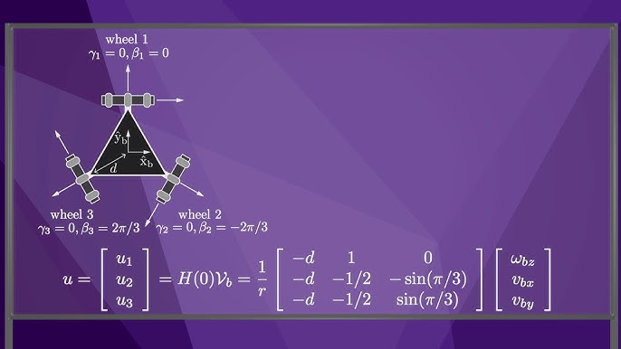
Mathematical Modeling
This matrix shows the orientation of each of the wheels and models the kinematics of the robot.
By using this matrix, the team can control where the robot applies the force needed.

Slide 13
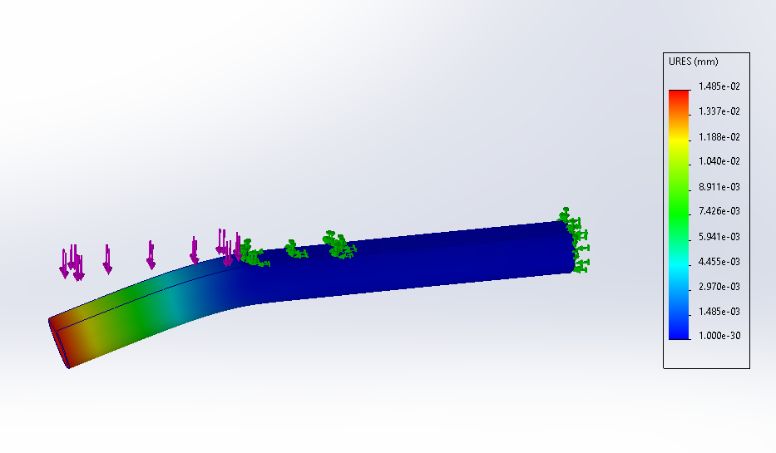
Mathematical Modeling
Bearing mounts are used to help prevent deflection of the motor shaft.
Using SimualtionXpress, without bearing supports and a force of 20lbf on the shafts the deflection is .0236mm with a FoS of .79
With the bearing mounts added and the same force applied to the shaft the deflection became .0148mm with a FoS of 1.4

Slide 14
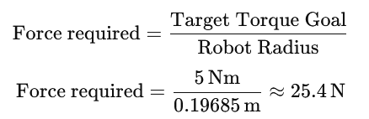
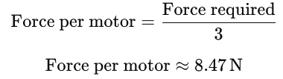
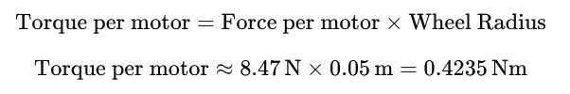
Mathematical Modeling
The goal of the team was to find the minimum amount of torque that each motor needs to reach the goal torque value.
It was found that each motor must be able to output .42 Nm of torque.

Slide 15
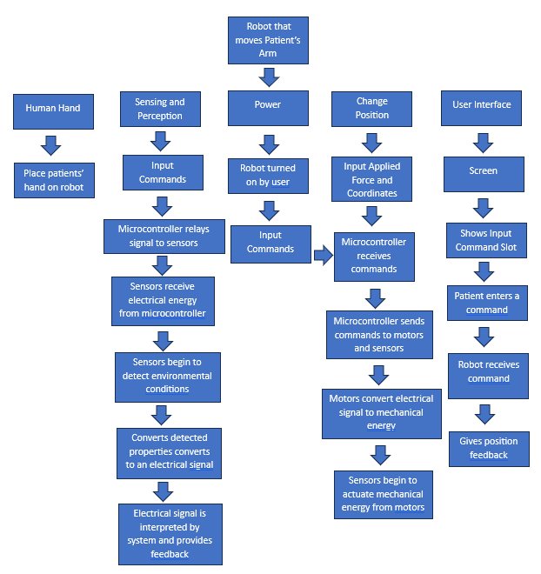
Functional Decomposition

Slide 16
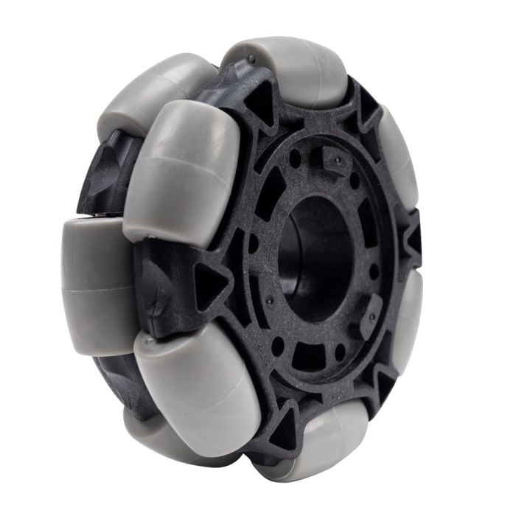
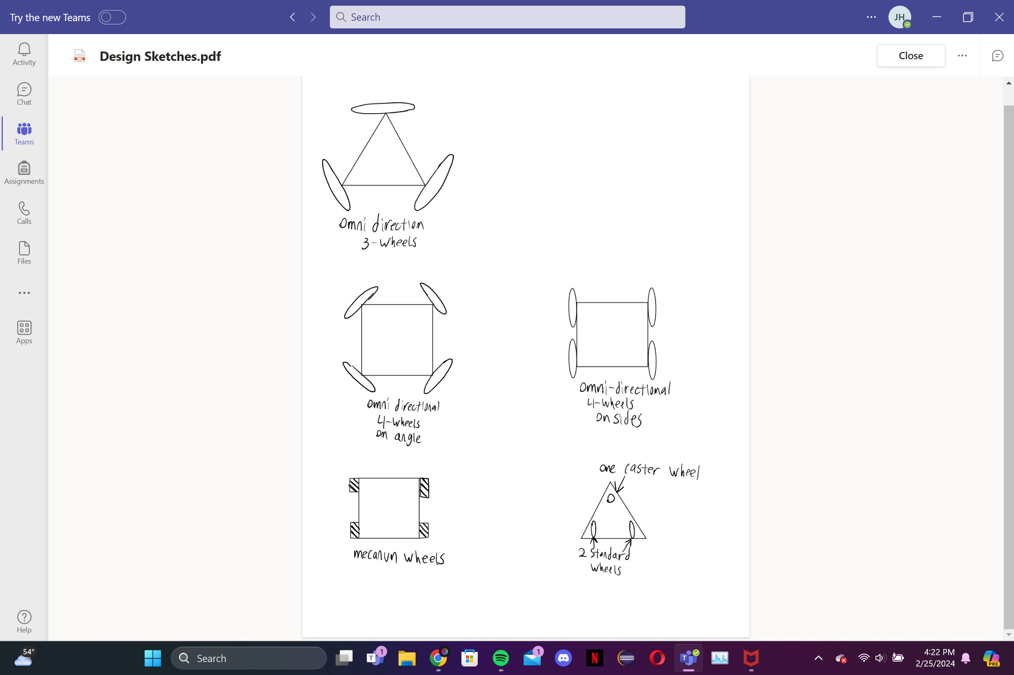
Concept generation: Wheel Layout
3 Omni-directional wheels
  Pros: Cheap, lots of maneuverability
  Cons: Difficult to program
4 Omni-directional wheels at angles
  Pros: More powerful
  Cons: More expensive, even harder to program
4 Omni-directional wheels on sides
  Pros: More powerful
  Cons: More expansive, Can't move horizontally
Mecanum Wheels
  Pros: Great control, easy to program
  Cons: Wheels are expensive
2 Standard Wheels and 1 caster wheel
  Pros: Cheap and easy to make
  Cons: Very limited mobility

Slide 17
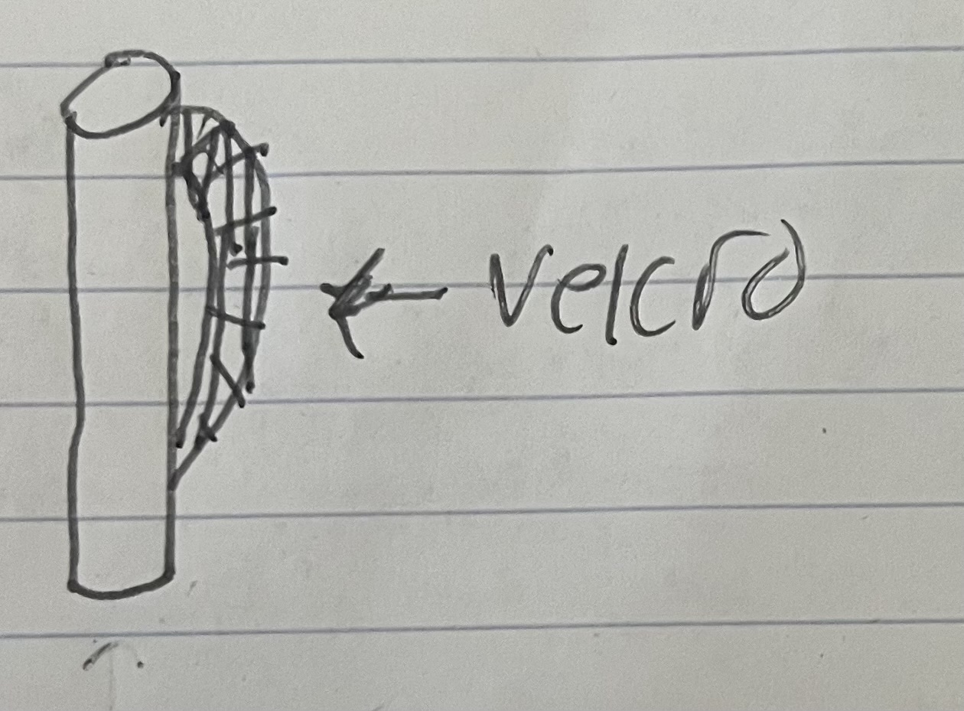
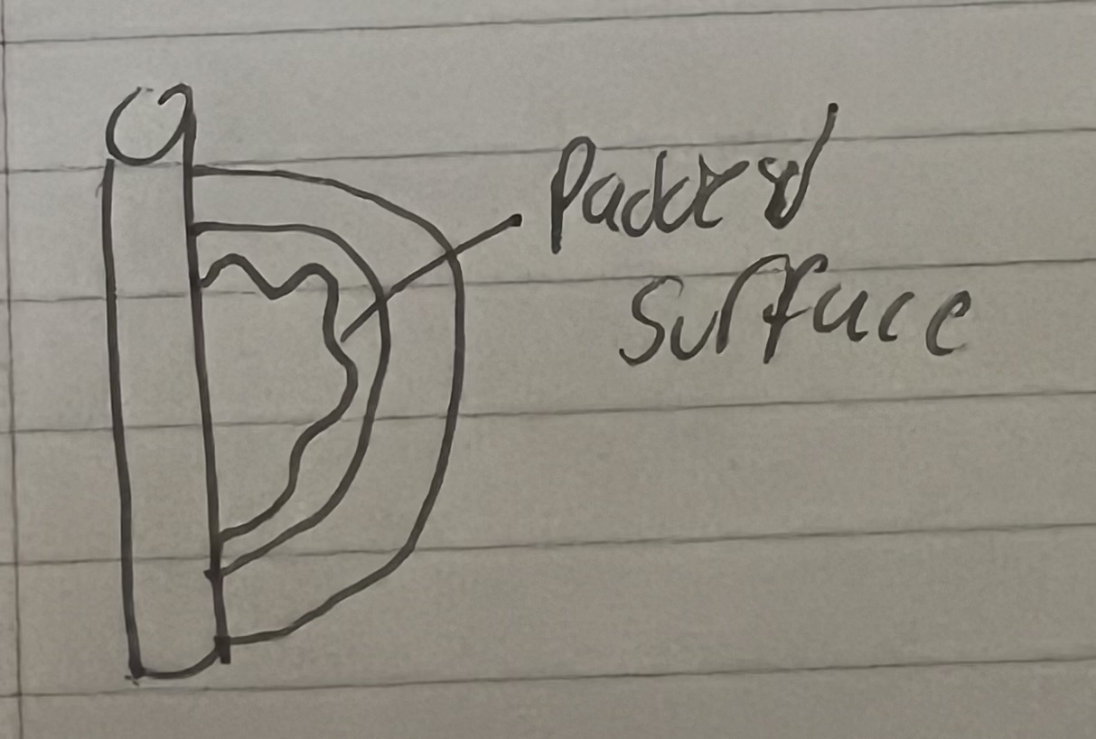
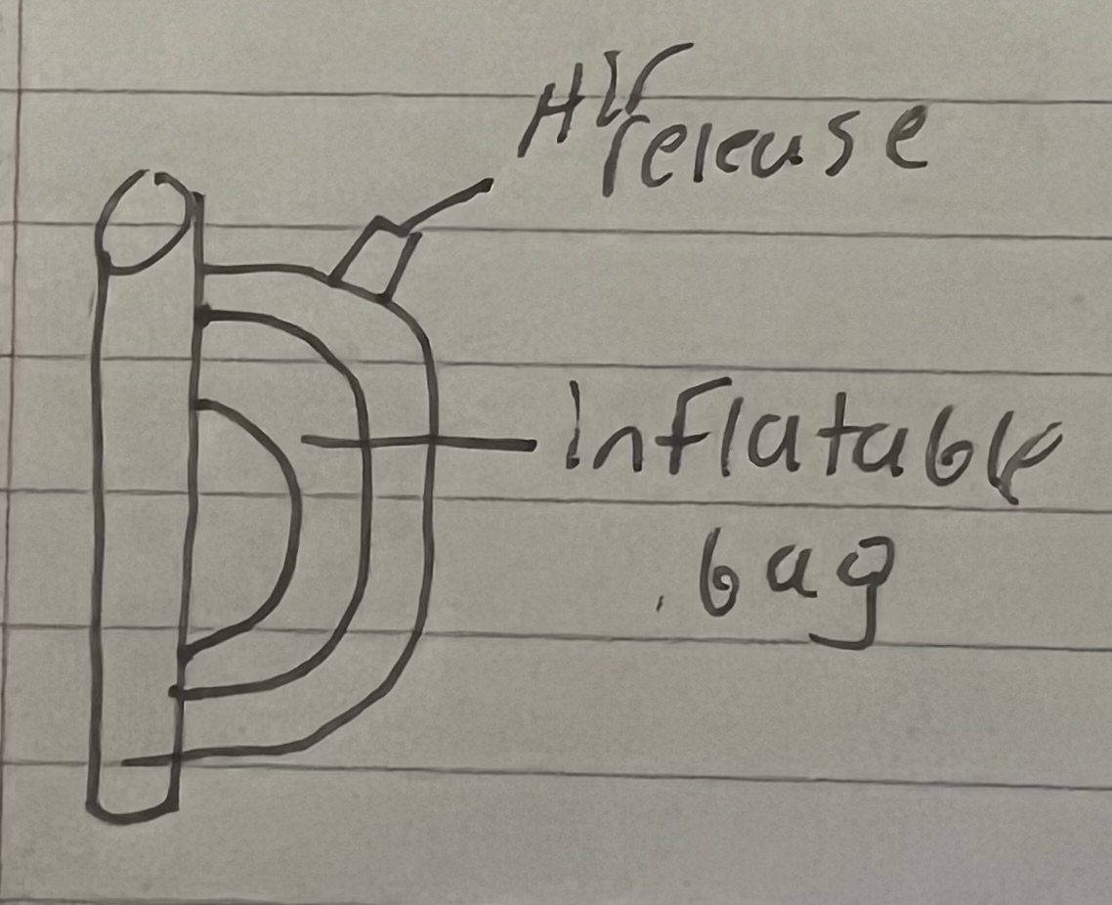
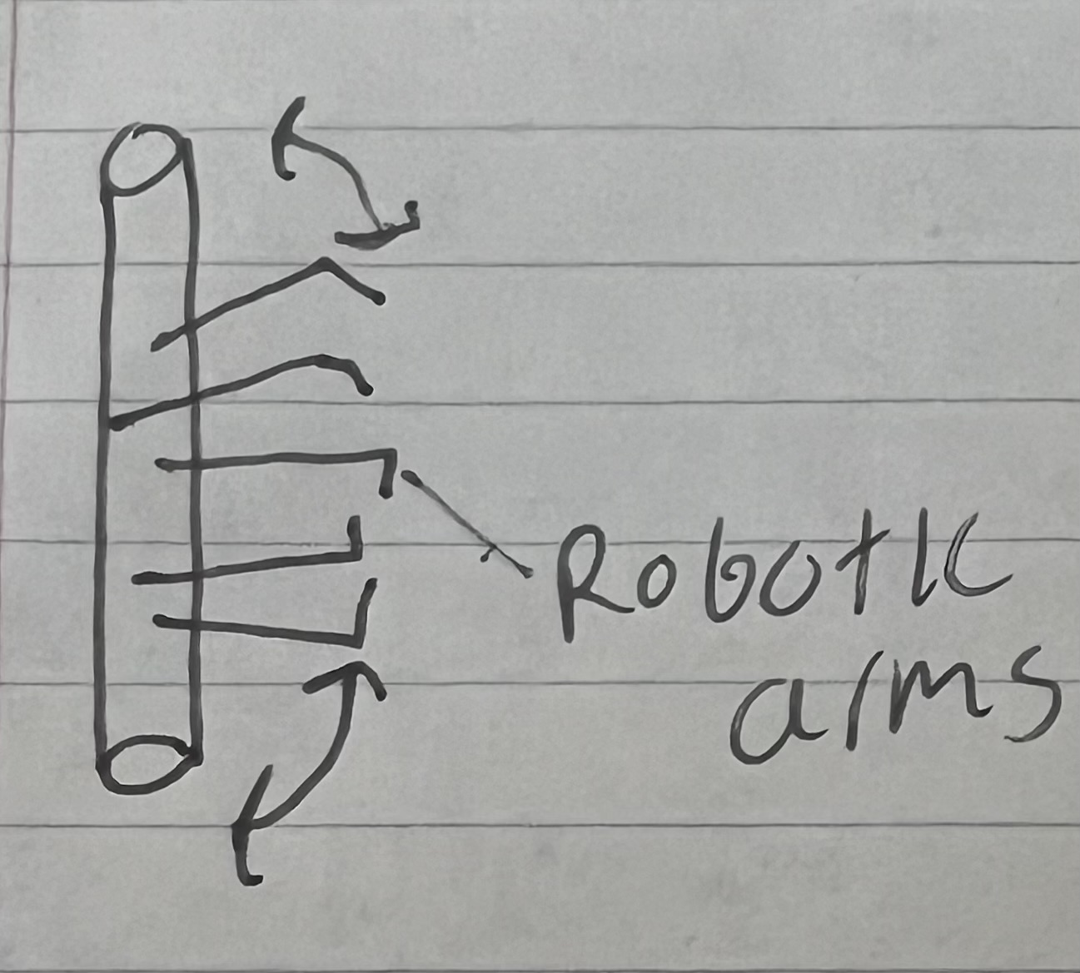
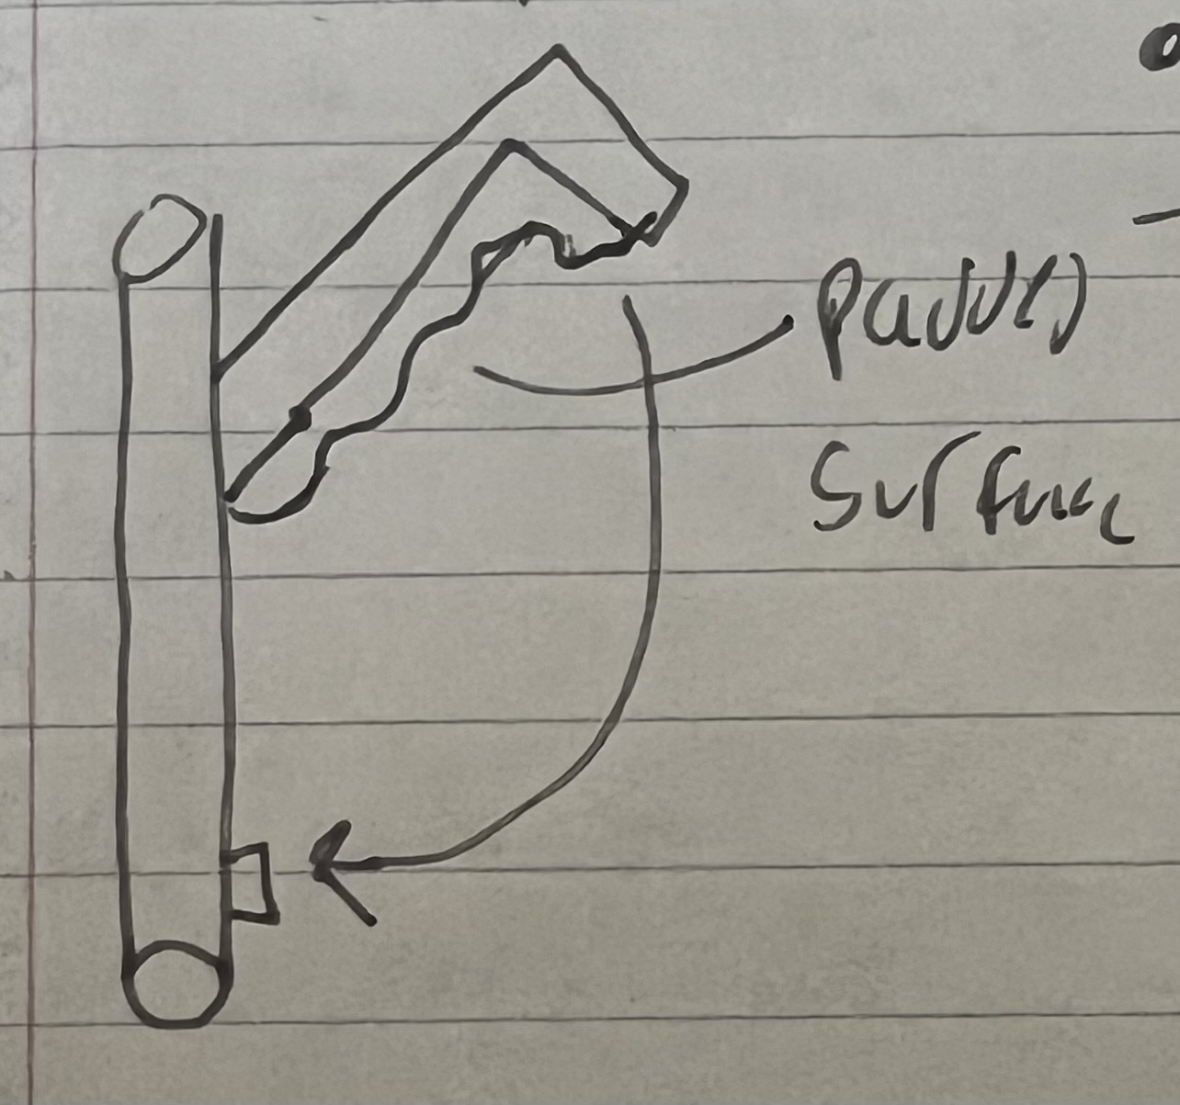
Concept generations: Hand attachment system
Velcro strap concept:
  Pros: Cheap and easy to use.
  Cons: May require two hands; potential irritation for some users.
Friction fit model:
  Pros: Super easy to use; soft material.
  Cons: Not a snug fit.
Air compression fit:
  Pros: Best fitting option.
  Cons: Potential structural issues.
Robotic claws:
  Pros: Automatic fitting.
  Cons: Safety concern if motors break.
Clamp idea:
  Pros: Cost-effective and simple.
  Cons: Not a snug fit.

Slide 18
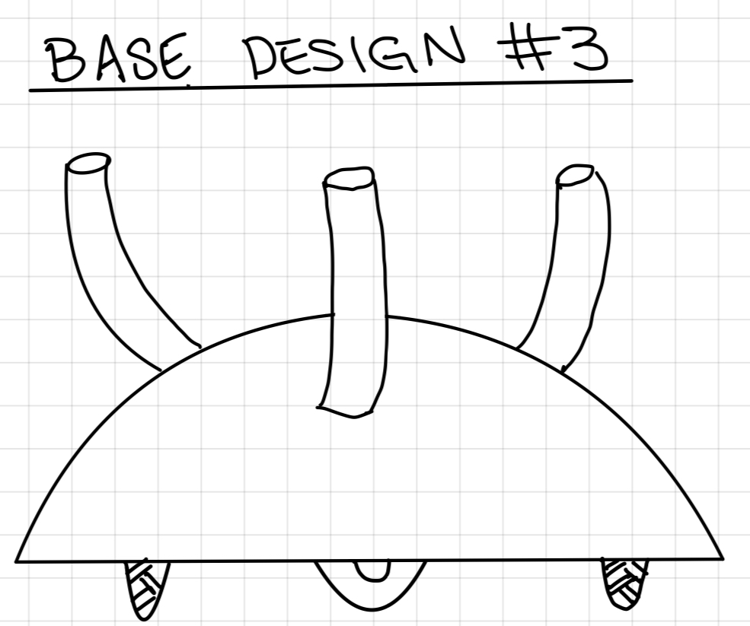
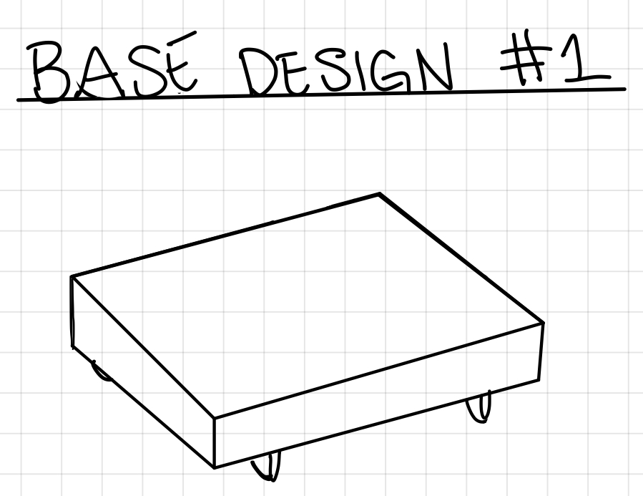
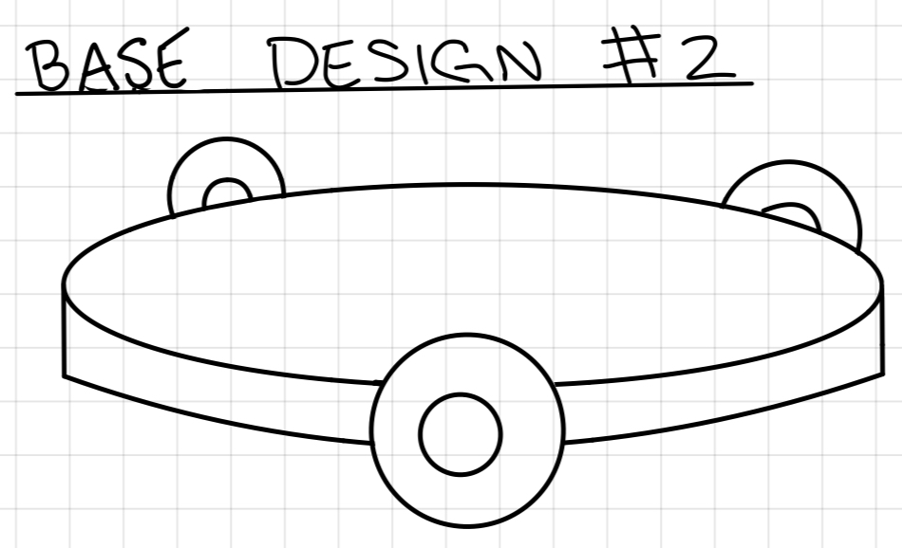
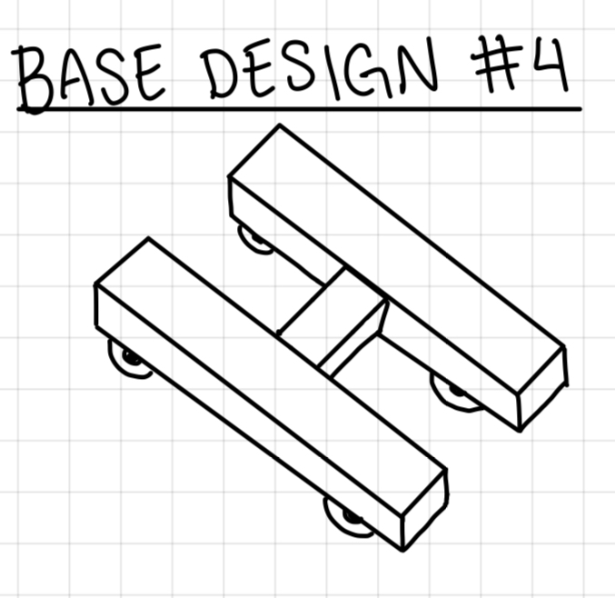
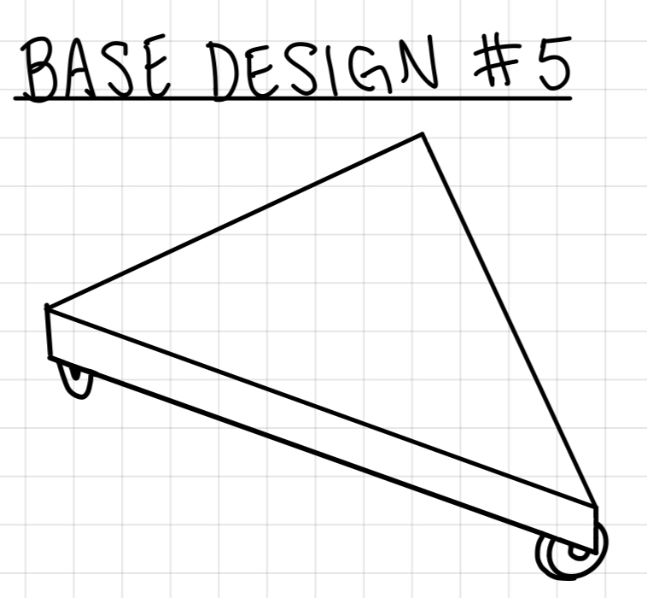
Concept generation: Chassis Design
Square Base
Pro: Be able to fit all components with ample space left over, screen could be placed on base
Con: Could be too large on a desk
Round Base
Pro: Compatible with 3 omni wheels design
Con: Could make it hard to fit all components inside
Dome Base
Pro: Most compatible with the robotic finger's
Con: Would be very tall compared to other designs
H Base
Pro: Less material used to create base
Cons: Will most likely require 4 wheels which increases costs, fitting all internals could prove to be difficult
Triangle Base
Pro: Works for 3-wheel design decreasing costs
Con: Minimal space for internals

Slide 19
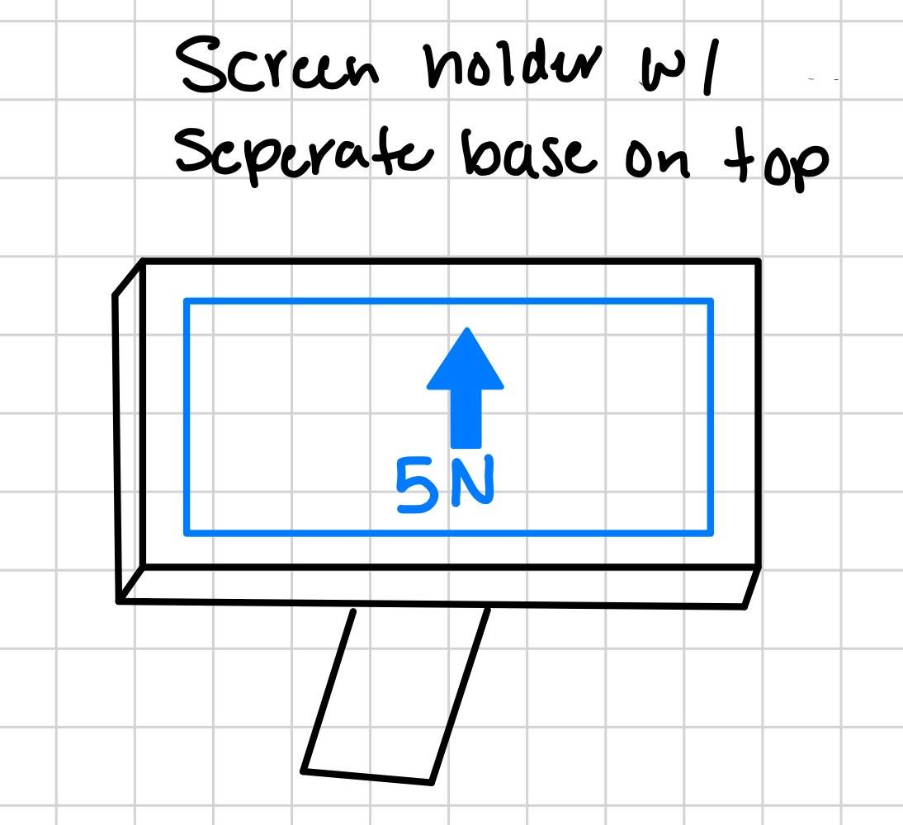
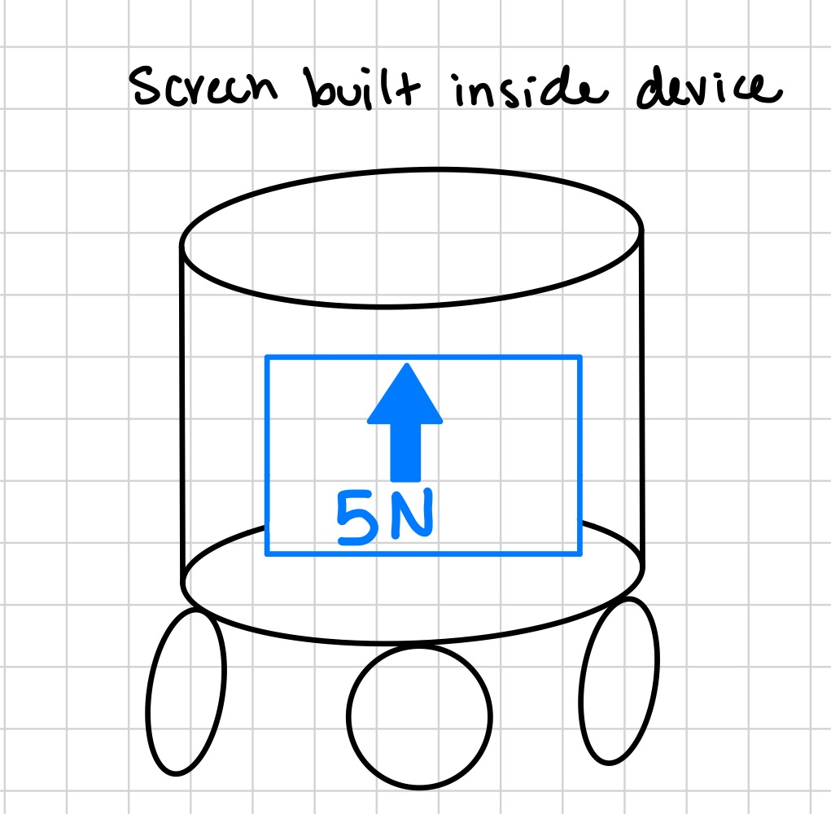
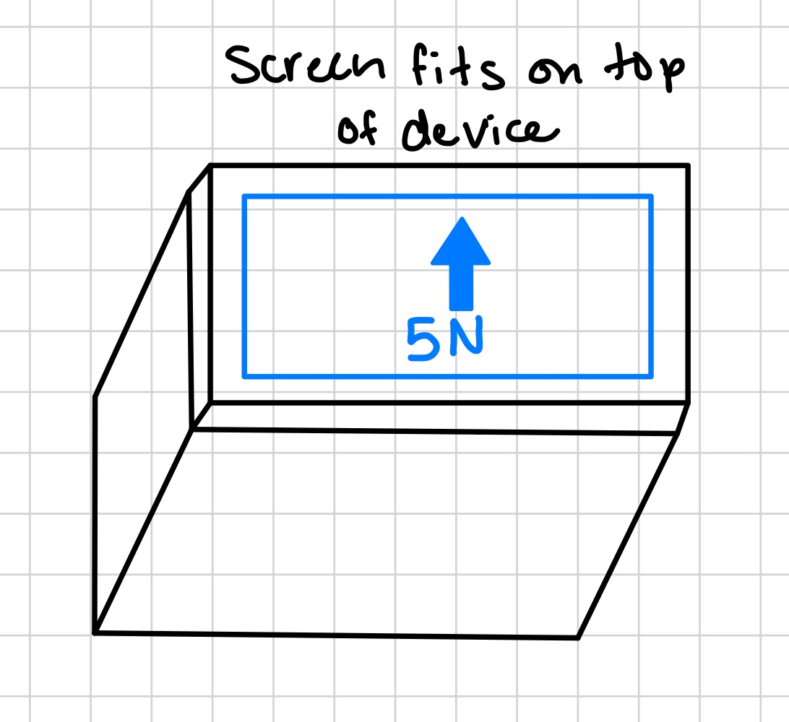
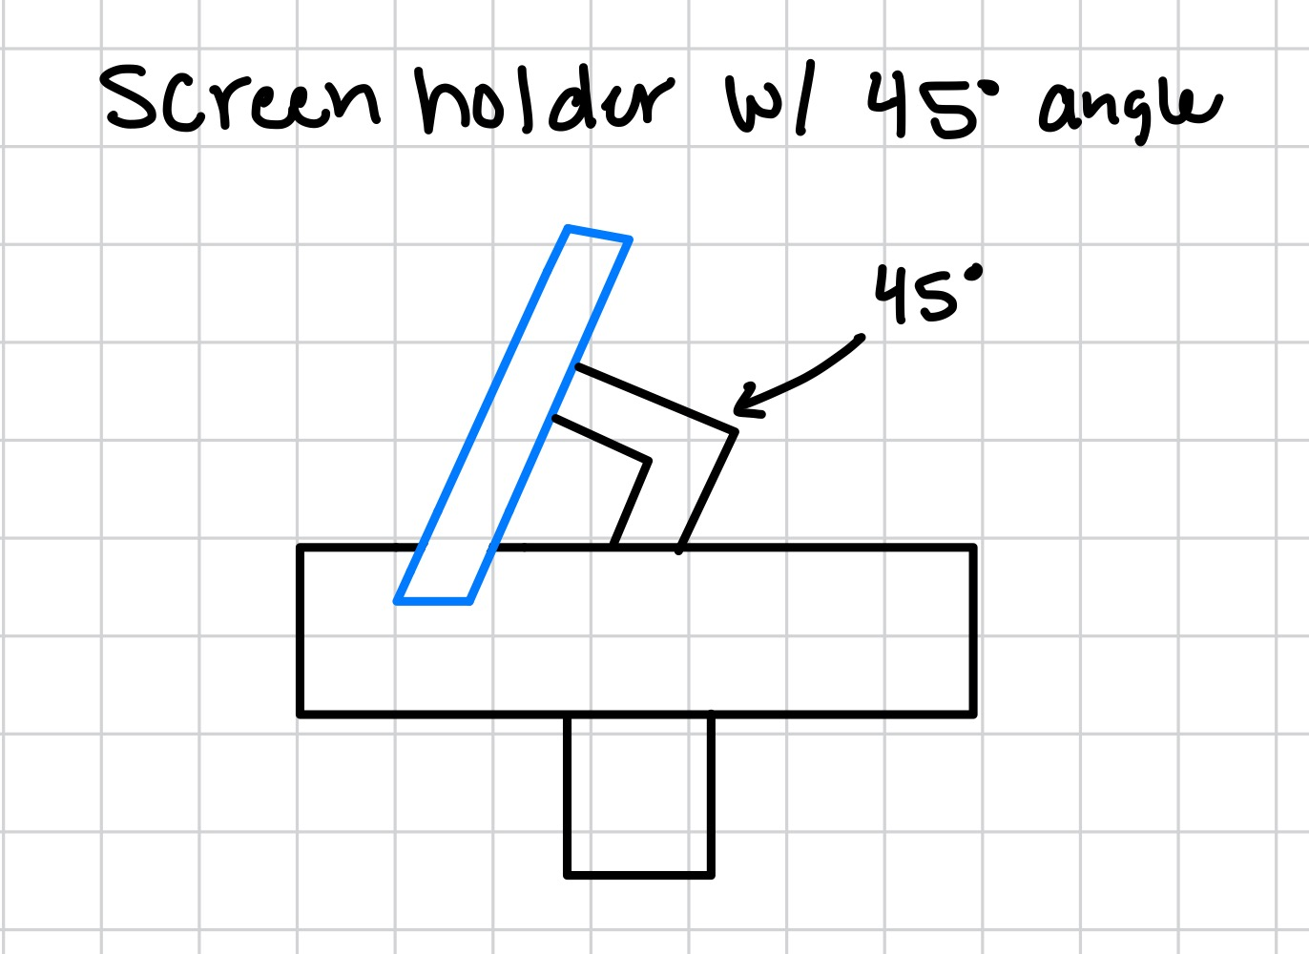
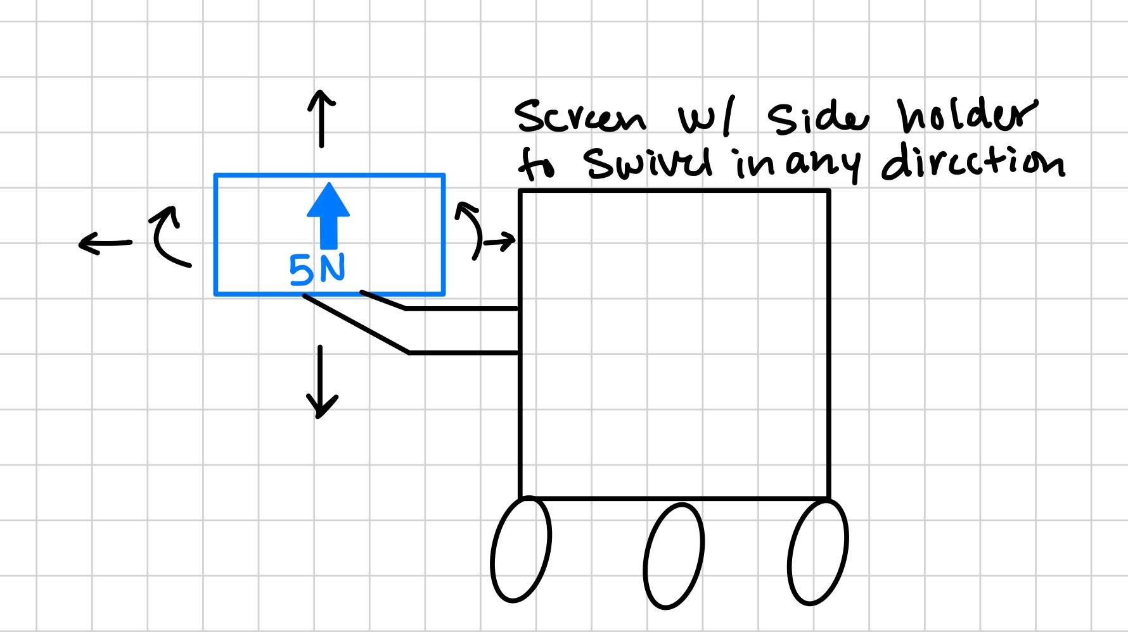
Concept generation: Screen Placement
Screen holder with sperate base on top
  Pro: Can adjust to clients view with less strain on eyes and neck
  Con: Easy to break and cost a little more
Screen built on device
  Pro: Fewer parts and cost
  Con: It can be hidden by an arm and can cause strain to the client's eyes or neck.
Screen built on top of device
  Pro: Fewer parts and cost
  Con: Can cause strain to client's eyes or neck.
Screen holder with bracket
  Pro: The angle bracket is more comfortable for the client. Can adjust for a moving device. Can switch from right-handed and left-handed clients
  Con: Septable to breaking. More parts and cost
Screen with side holder arm
  Pro: Can switch from right-handed and left-handed clients. It can rotate and move horizontally and vertically.
  Con: Added length to device. Will start to get loose after multiple adjustments are made. Can easily break if it takes a fall.

Slide 20
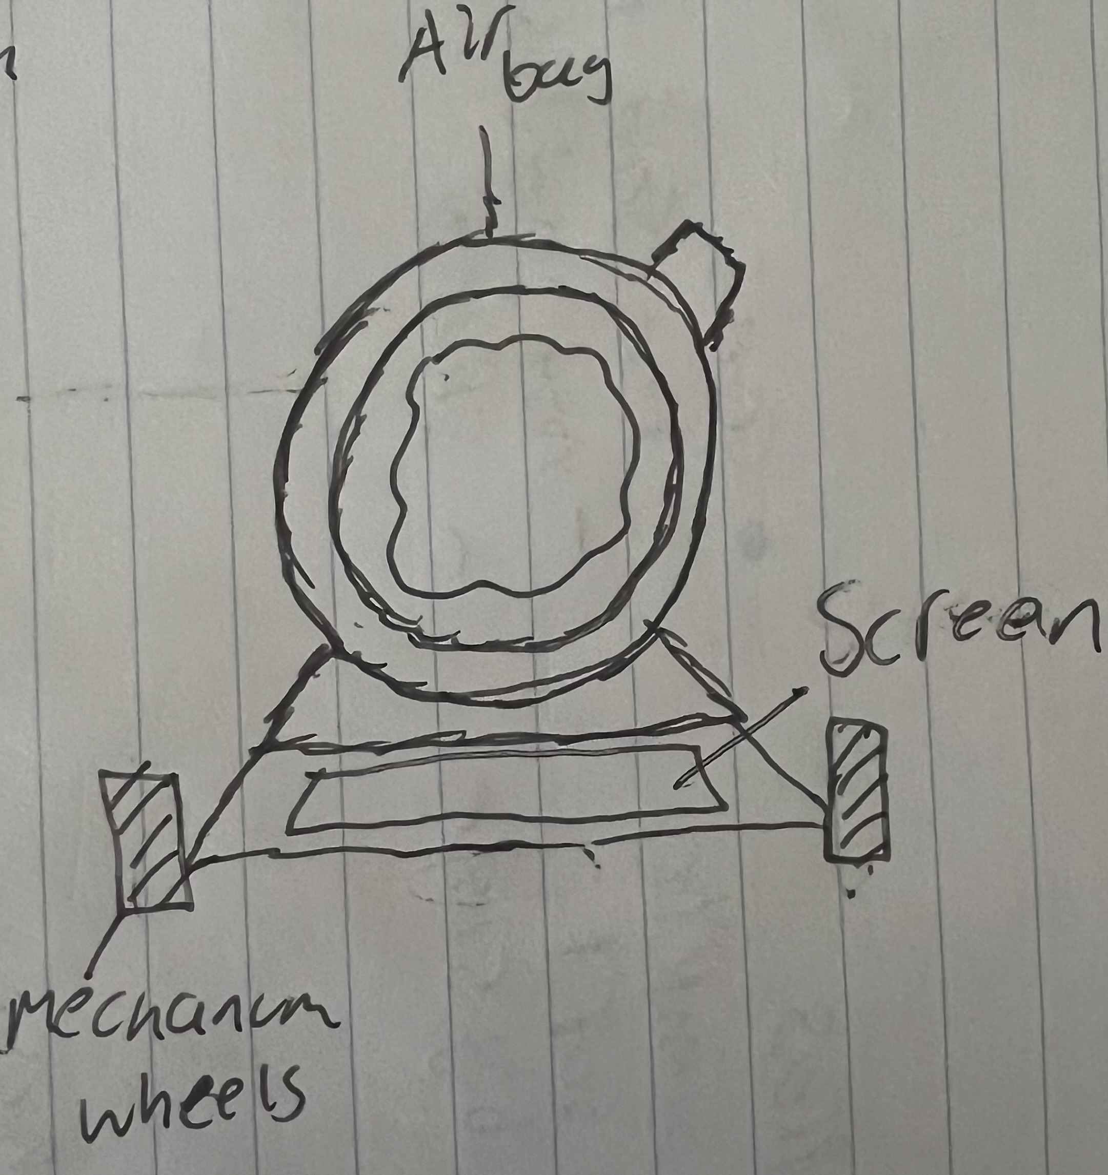
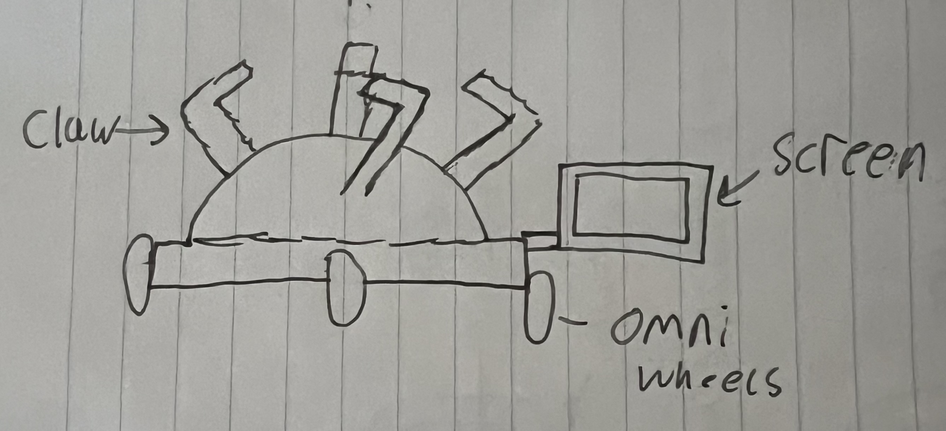
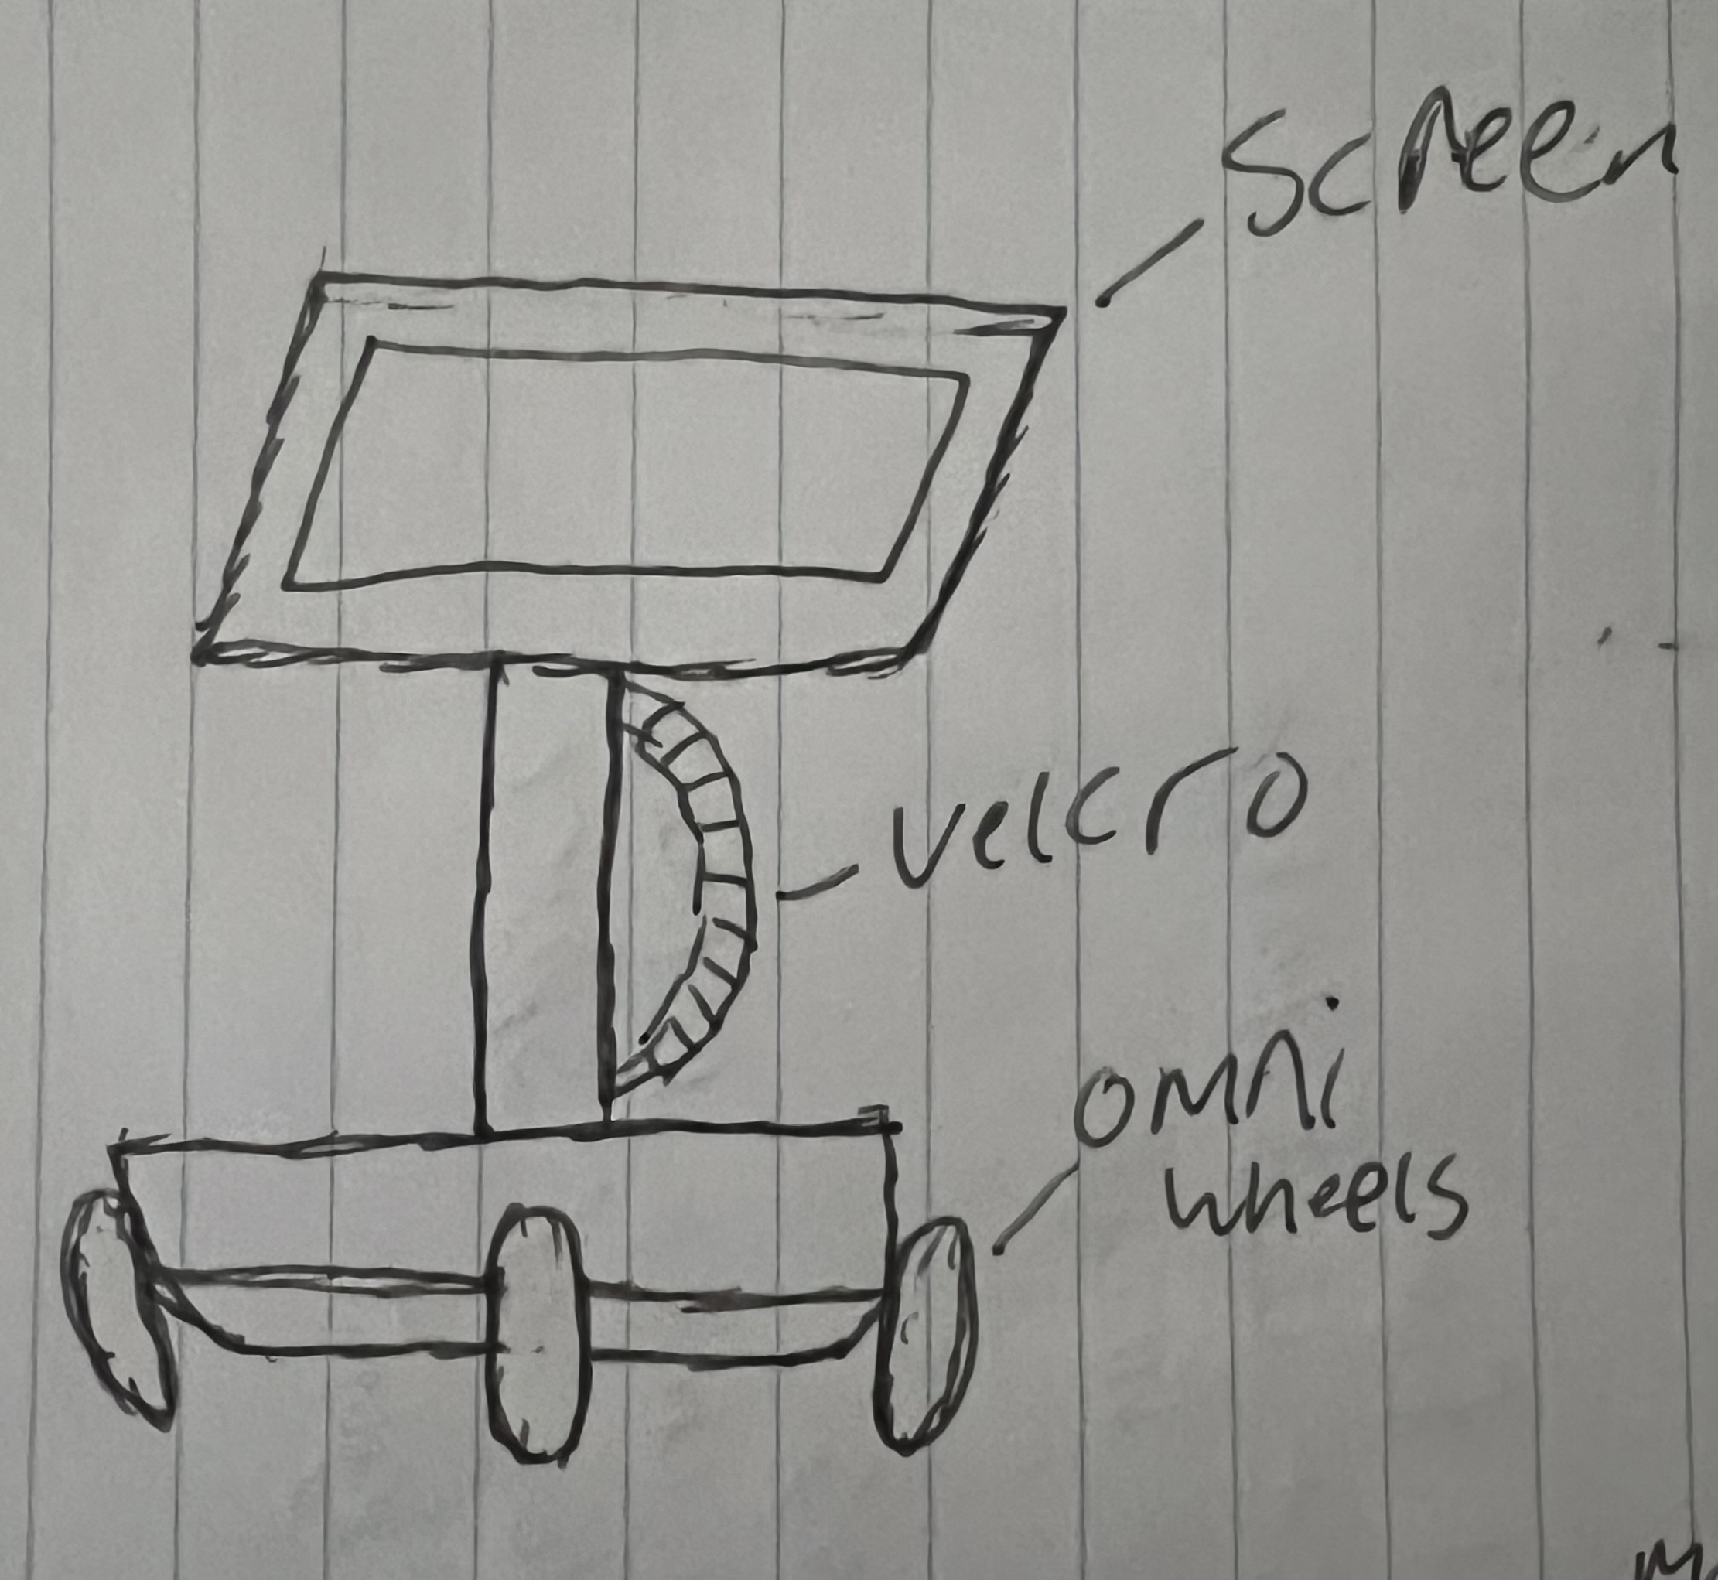
Designs in Decision Matrix
Design #2
Design #1
Design #3

Slide 21
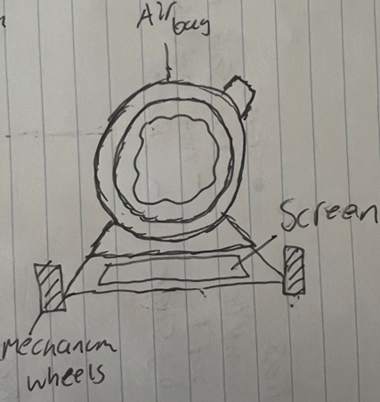
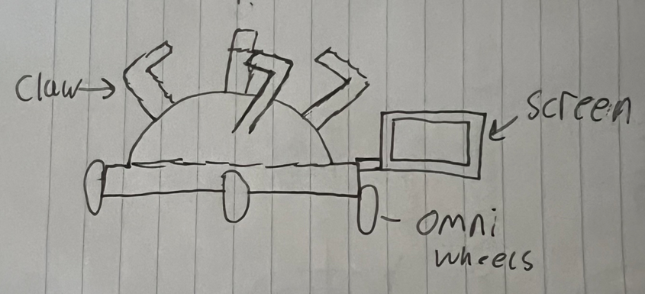
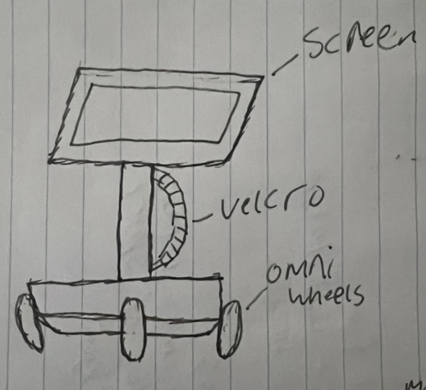
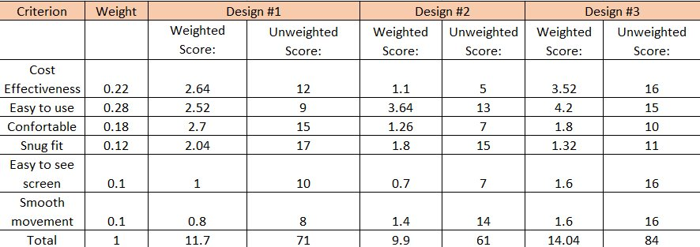
Selection Criteria

Slide 22
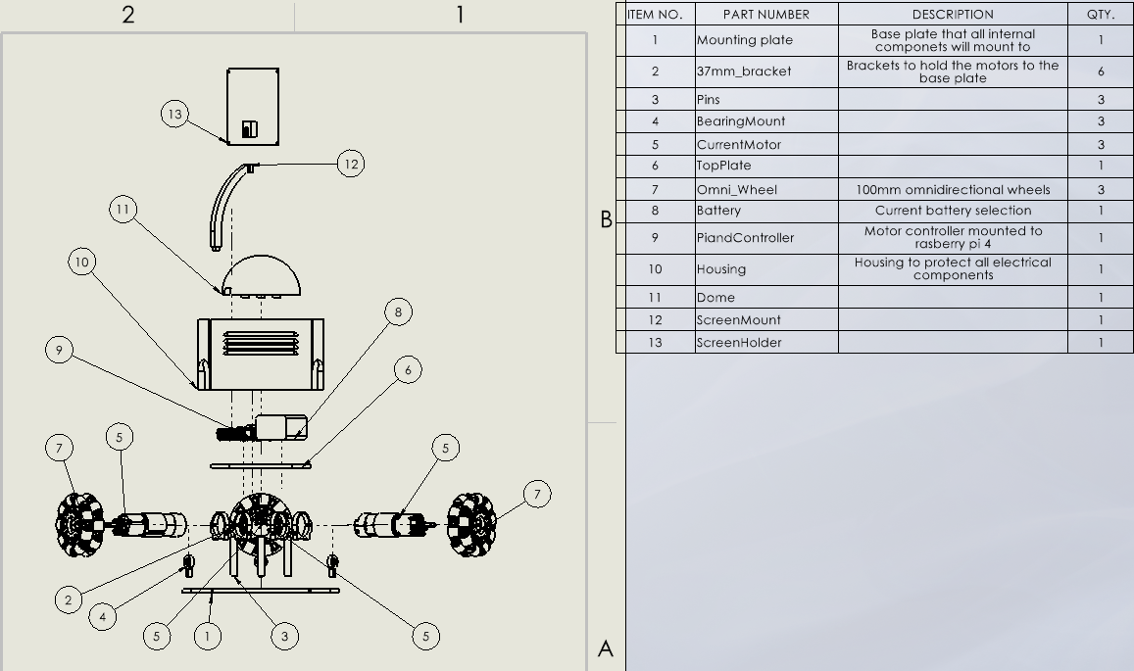
Concept Selection

Slide 23

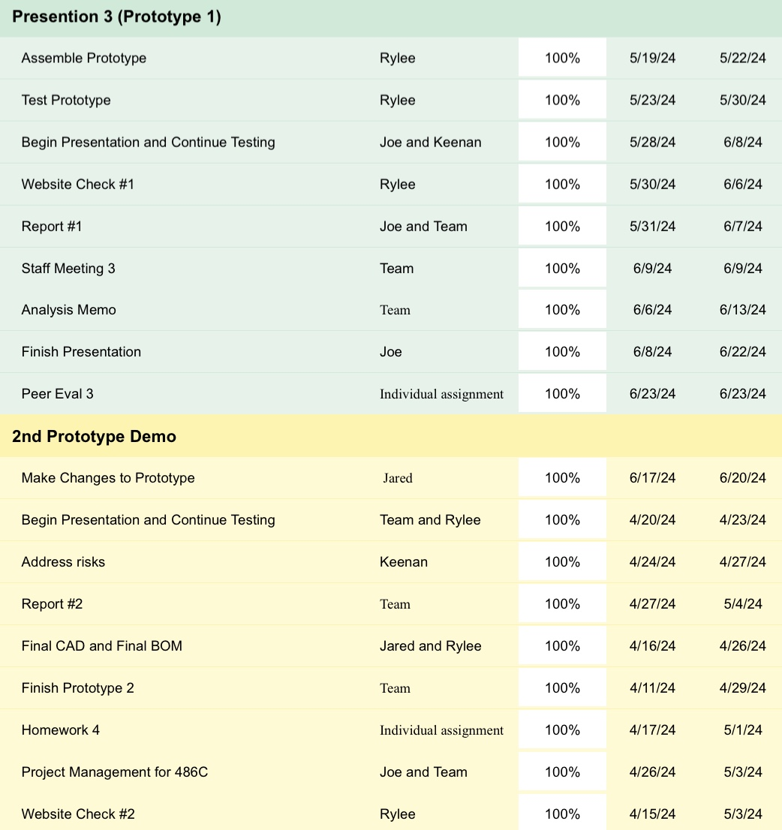
Schedule: First Semester

Slide 24
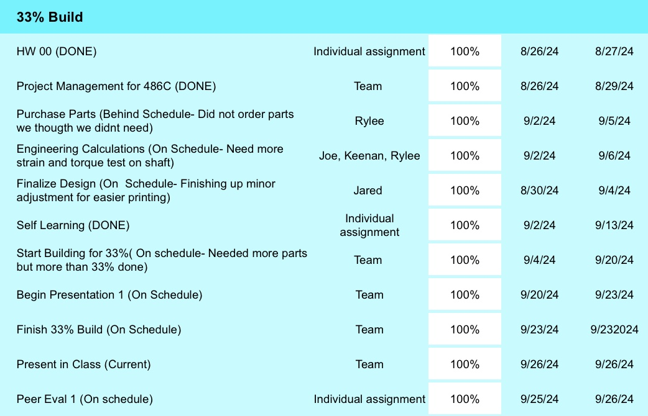
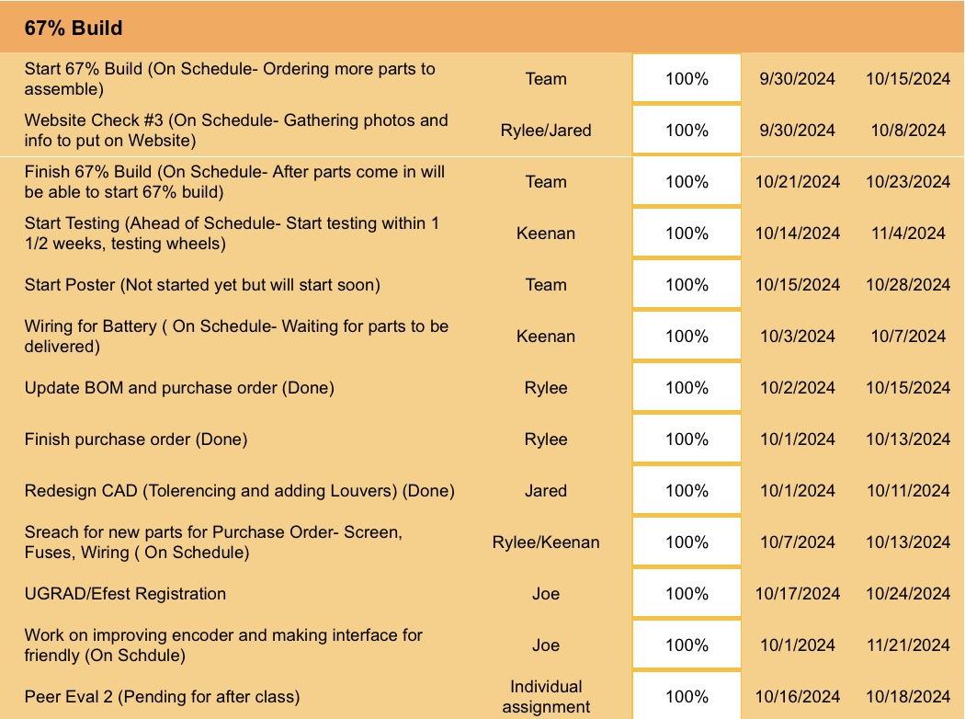
Schedule: Second Semester

Slide 25
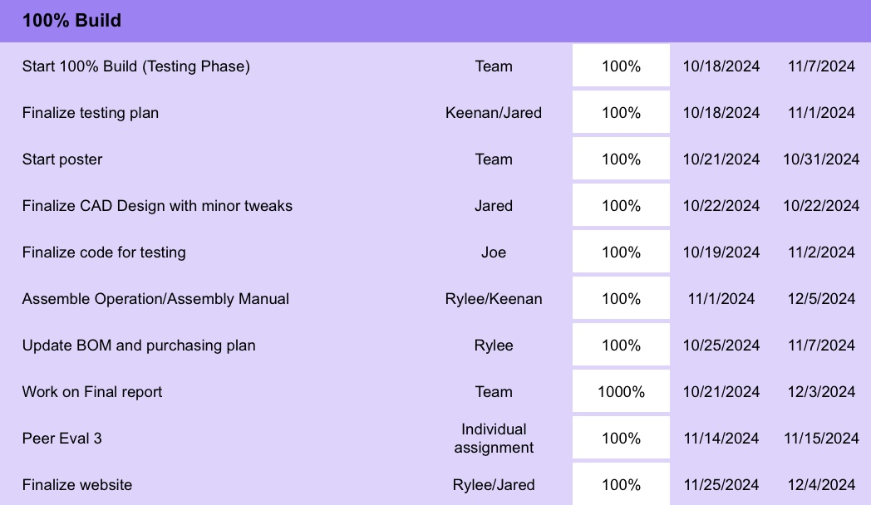
Schedule: Second Semester

Slide 26
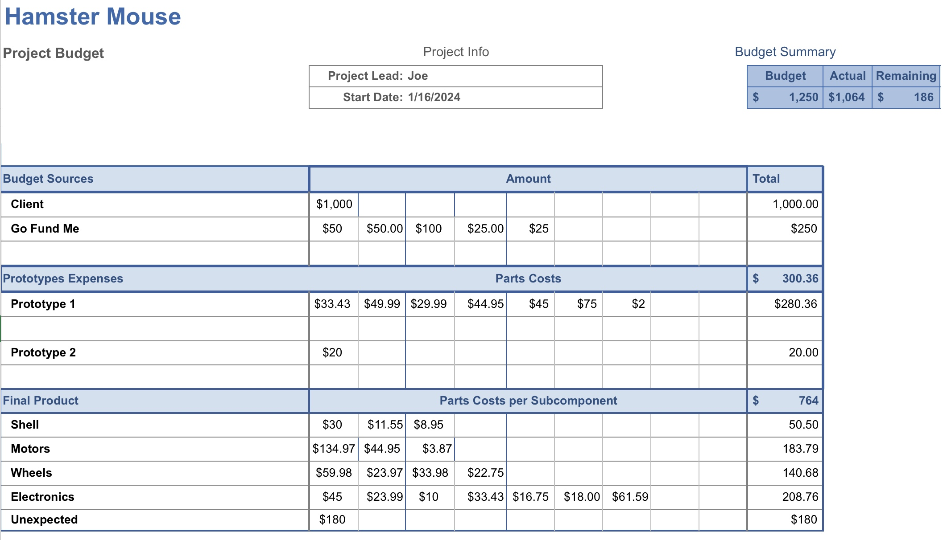
Budget

Slide 27
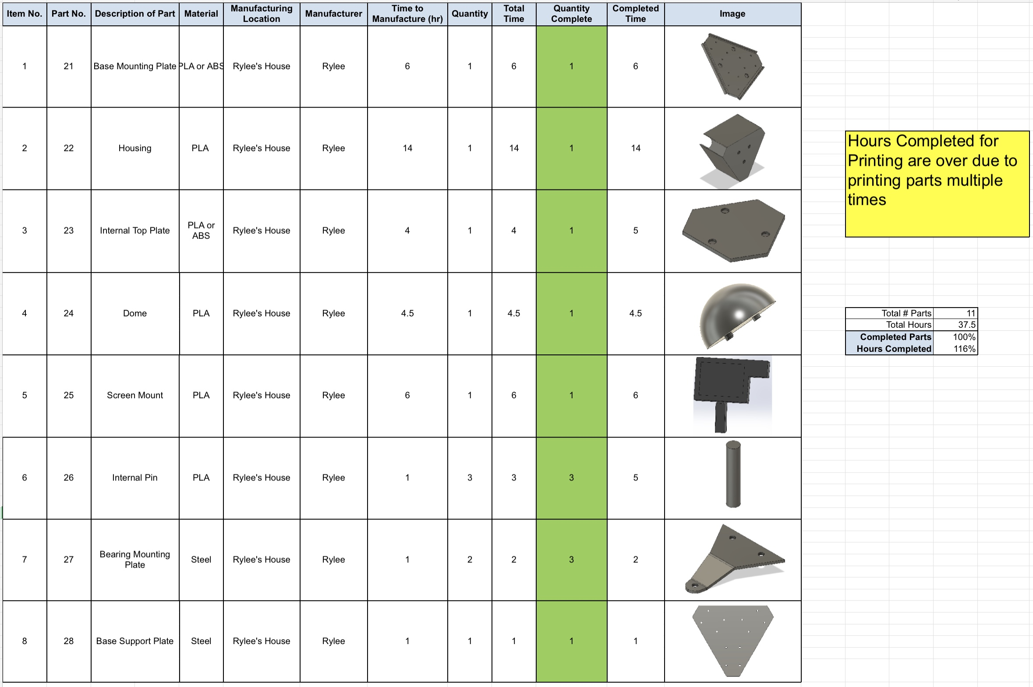
Manufacturing Bill of Materials

Slide 28
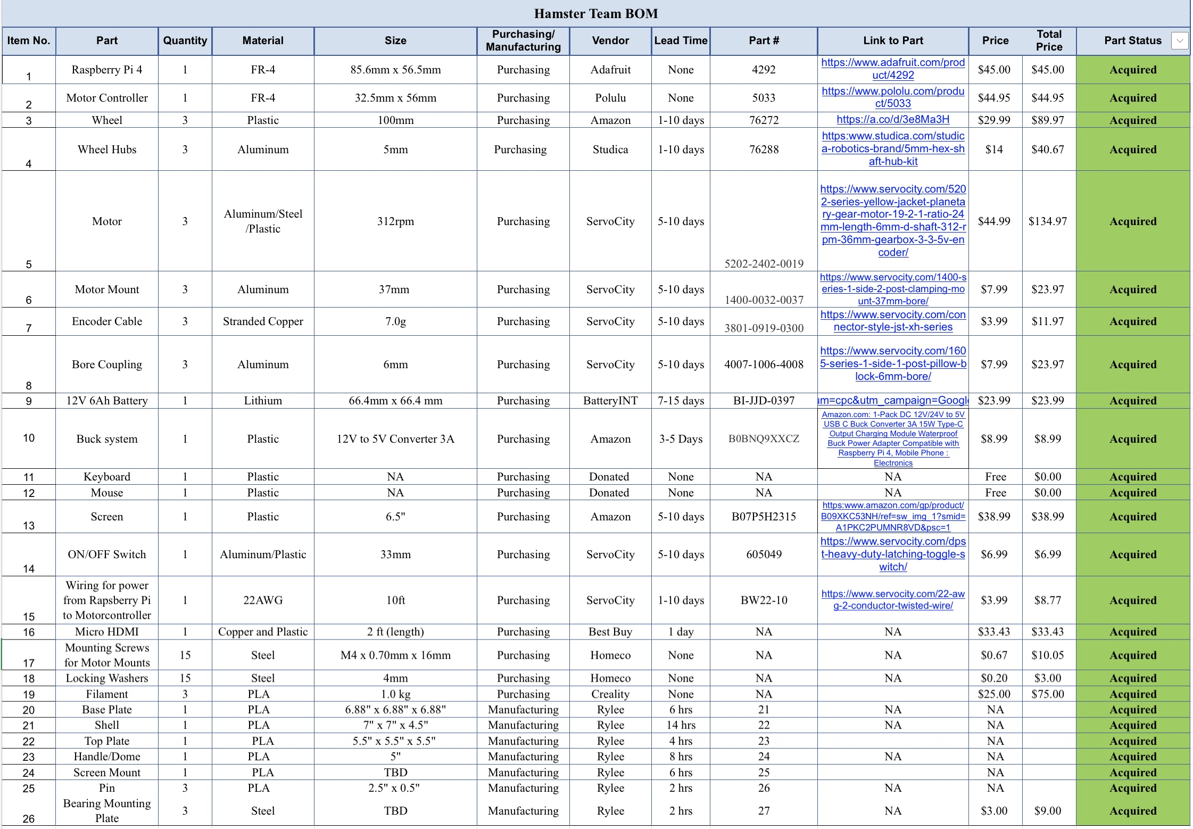
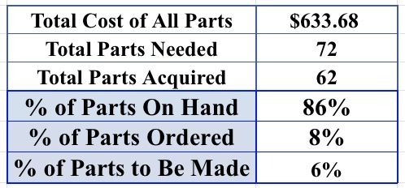
Bill of Materials

Slide 29
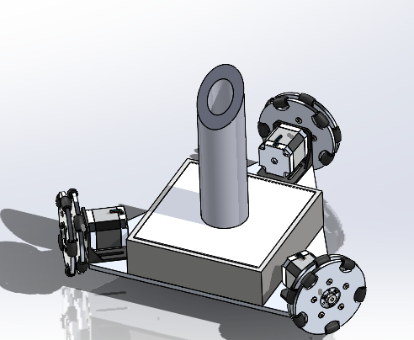
Iteration 1
Overall design was too big and the housing was too small to fit all components
Initially used stepper motors but client suggested against them.

Slide 30
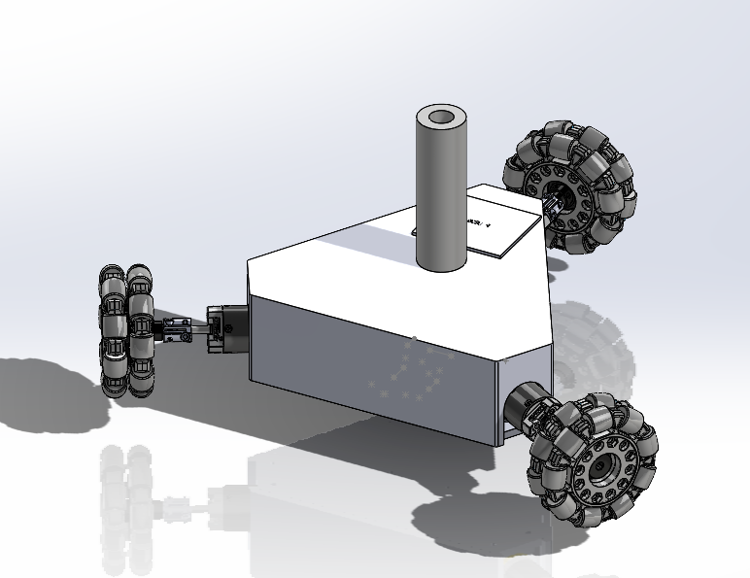
Iteration 2
Housing became larger to accommodate all components, but overall design became too large (13in wheel to wheel)
No room to mount the screen
Motor shafts were at risk of being damaged during use

Slide 31
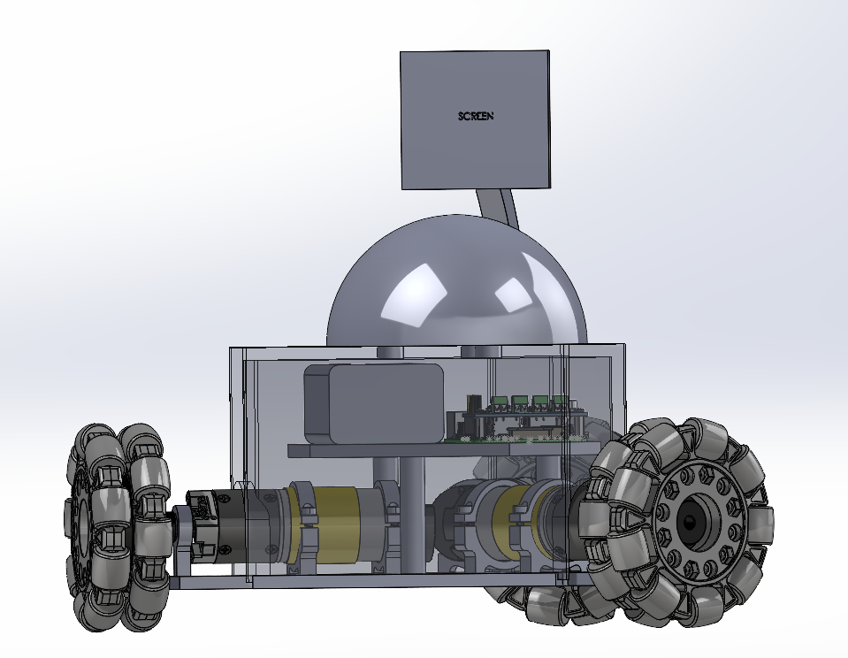
Iteration 3
Used 2 layered design to make a more compact design
Bearing mounts were used at the end of each shaft to prevent deflection
Switched from an upright handle to a dome

Slide 32
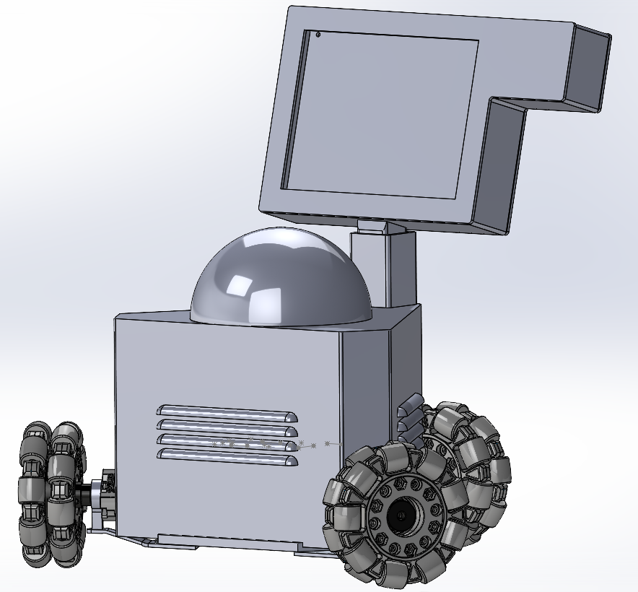
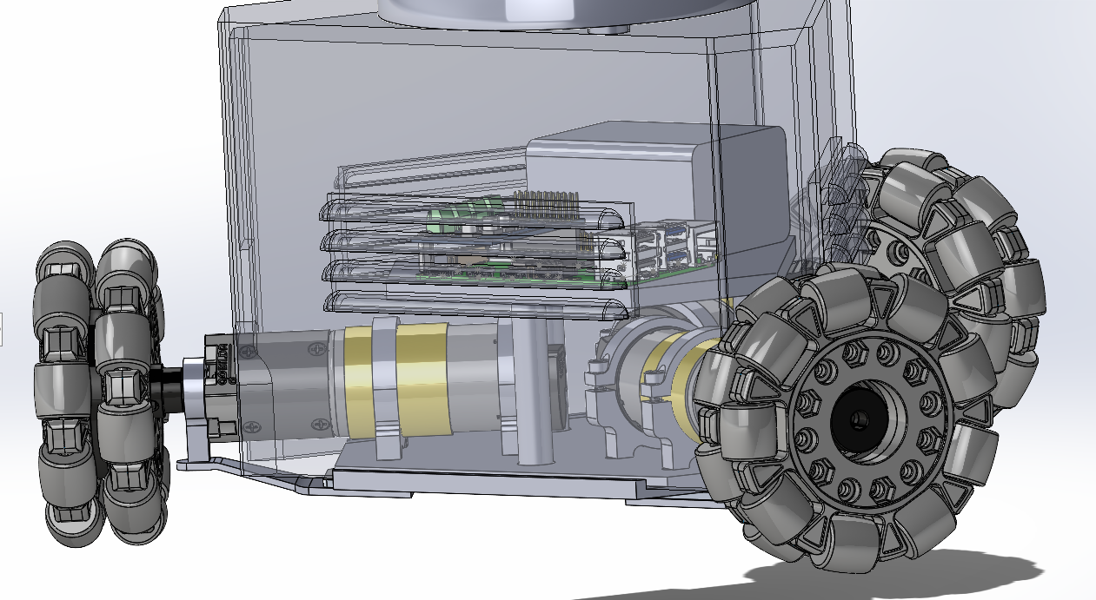
Final Prototype

Slide 33
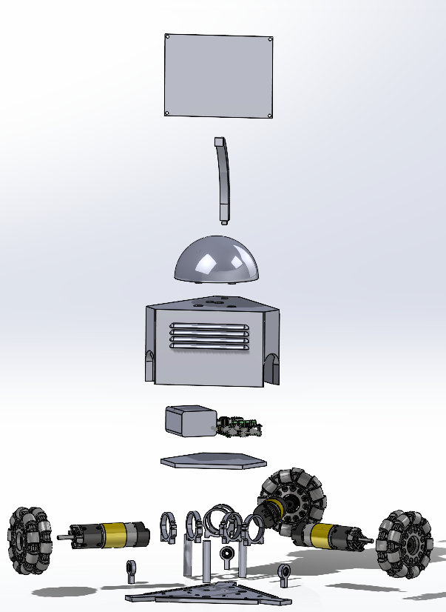
Exploded View

Slide 34
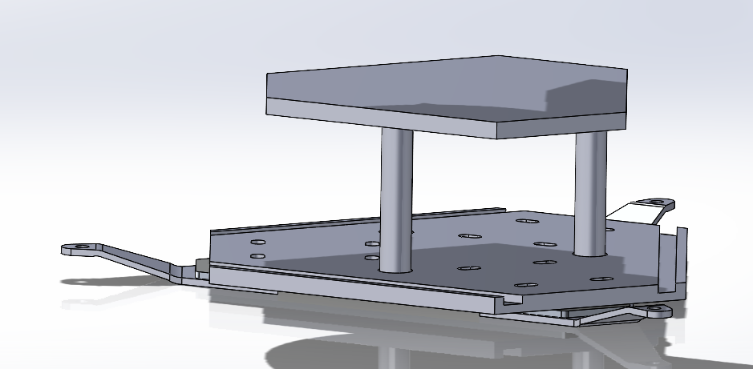
2 Layered Internal Housing
  Minimizes overall space needed to house all internal components
  Battery, Raspberry Pi, Motor Controller, and Buck Converter are stored on the top layer
  Motors and Motor Mounts are placed on the bottom layer

Slide 35

Bearing Mounts & Support Plate
Bearing mounts were used to help prevent deflection of the motor shaft.
A support plate made out of steel was added to increase support for the bearing mount

Slide 36

Shell
The shell is used to contain all internal components
Louvers are placed on each side of the shell to allow for proper cooling of the raspberry pi and the motors

Slide 37
Testing Summary
Experiment/ Test | Relevant Design Requirements
EX 1: Prony Brake | CR 2, CR 3, ER 1
EX 2: Force Output Test | CR 3, CR 4
EX 3: Duration Test | CR 6, ER 2, ER 3
EX 4: Position Test | CR 5, CR 7

Slide 38

Experiment 1: Prony Brake
The Prony Brake test will verify if the selected motors can produce the required torque at specified speeds, ensuring the robot meets the customer’s requirement of exerting 10N of force on the patient’s hand. To conduct this test, the team will design a Prony brake test rig, including a drum, tachometer, rope, hooks, washers, and scales. The test will isolate variables such as force measurements and motor RPM under load, enabling the calculation of torque and motor power output. This data will confirm whether the motors meet the team’s engineering and customer requirements.

Slide 39
Experiment 2: Force Output Test
The force output test will confirm that the robot can generate the required 10 N of force, as specified in the customer requirements, and verify that a patient can move the robot with just 5 N of force when the motors are not in use. The test will use a testing rig and a spring scale, with the scale attached to the rig via an eye hook. The isolated variable will be the force measured by the spring scale as the robot produces different levels of force. The results will be direct numerical readings that show the robot's force output during operation and manual movement.

Slide 40
Experiment 3: Duration Test
The duration test will measure the battery's ability to power the robot’s motors, screen, and internal components while meeting the required runtime of 30 minutes on a single charge. This test will validate engineering requirements 2 and 3, as well as customer requirement 6. The robot will undergo various force and speed simulations, with a stopwatch used to track the battery's run time. If the battery fails to meet the 30-minute requirement, the team will recalculate the system’s amperage and ensure it aligns with the desired battery life.

Slide 41
Experiment 4: Position Test
The position test ensures the hamster system can accurately locate itself within a designated area. During the test, the system will run for a set time, and we’ll measure the distance traveled and the motor speed. The required equipment includes a measuring tape, the hamster robot, and ample space for testing. We’ll isolate variables such as distance (in meters), time (in seconds), and speed (in meters per second), calculating the distance traveled over time to set a boundary in the code that keeps the robot within the desired area.

Slide 42
Customer Requirements Met
Customer Requirement | CR Met? (Y or N) | Client Acceptable (Y or N)
CR 1- Size | Y | N
CR 2- Speed | Y | Y
CR 3- Force | Y | Y
CR4- Internal Friction | Y | Y
CR 5- Backlash | N | N
CR 6- Run Time | Y | Y
CR 7- Interface | Y | Y
CR 8- Screen | Y | Y
CR 9- Cost | Y | Y
CR 10- Microcontroller | Y | Y
CR 11- Ease of Use | Y | Y
CR 12- Comfortable | Y | Y

Slide 43
Engineering Requirements Met
Engineering Requirement | Target | Tolerance | Measured/ Calculated Value | ER met? (Y or N) | Client Acceptable (Y or N)
ER 1- Motor Torque | 0.42 Nm | +/- 0.05 Nm | 2.4 Nm | Y | Y
ER 2- Battery Life | 30 mins | +/- 5% of target | >30 mins | Y | Y
ER 3- Battery Amperage | 6 Ah | +/- 5% | 6 Ah | Y | Y
ER 4- Size | < 12in³ | +/- 2” for all | ~8in³ | Y | Y
ER 5- CPU Speed | 16MHz | +/- 5% of target | 1.5 GHz | Y | Y
ER 6- Weight | <10lbs | +/- 1 lb. | 10.7 lbs | Y | Y

Slide 44
Future Work
Add force sensors so that the robot can be controlled using force feedback
Continue iterating to allow for a more compact design
Develop UI so the robot can be controlled using the touchscreen alone

Slide 45
Thank you

Slide 46
References
J. Brackenridge, L. V. Bradnam, S. Lennon, J. J. Costi, and D. A. Hobbs, “A Review of Rehabilitation Devices to Promote Upper Limb Function Following Stroke,” Neuroscience and Biomedical Engineering, vol. 4, no. 1, pp. 25–42, Mar. 2016, Available: https://www.ingentaconnect.com/content/ben/nbe/2016/00000004/00000001/art00006
P. Weiss, M. Heldmann, A. Gabrecht, Achim Schweikard, T. M. Münte, and E. Maehle, “A Low Cost Tele-Rehabilitation Device for Training of Wrist and Finger Functions After Stroke,” A low cost tele-rehabilitation device for training of wrist and finger functions after stroke, Jan. 2014, doi: https://doi.org/10.4108/icst.pervasivehealth.2014.255331.
T. Georgiou, S. Holland, and Janet, “Wearable haptic devices for post-stroke gait rehabilitation,” Open Research Online (The Open University), Sep. 2016, doi: https://doi.org/10.1145/2968219.2972718.
L. Riek, Healthcare robotics, vol. 60, no. 11, Oct. 2017, doi: https://doi.org/10.1145/3127874.
J. Duval et al., “Designing Spellcasters from Clinician Perspectives,” ACM Transactions on Accessible Computing, vol. 15, no. 3, Apr. 2022, doi: https://doi.org/10.1145/3530820.
C. Axel et al., “Engineering Rehabilitation: Blending Two Tool-supported Approaches to Close the Loop from Tasks-based Rehabilitation to Exercises and Back Again,” Proceedings of the ACM on human-computer interaction, vol. 7, no. EICS, pp. 1–23, Jun. 2023, doi: https://doi.org/10.1145/3593229.
Dharmaraja Selvamuthu and P. Tardelli, “Partial Observed Fluid Queue Model for Rechargeable Batteries,” Partial Observed Fluid Queue Model for Rechargeable Batteries, May 2020, doi: https://doi.org/10.1145/3388831.3388856.
R. Ramirez, “How to Power Your Raspberry Pi With a Battery,” Circuit Basics, Jul. 29, 2021. https://www.circuitbasics.com/how-to-power-your-raspberry-pi-with-a-lithium-battery/
S. Hu, H. Chen, and Y. Shao, “Triangular Omnidirectional Wheel Motion Control System,” OALib, vol. 07, no. 08, pp. 1–8, 2020, doi: https://doi.org/10.4236/oalib.1106677.
Pololu, “Pololu Motoron Motor Controller User’s Guide,” www.pololu.com. https://www.pololu.com/docs/0J84/all (accessed Apr. 27, 2024).

